Slide 1
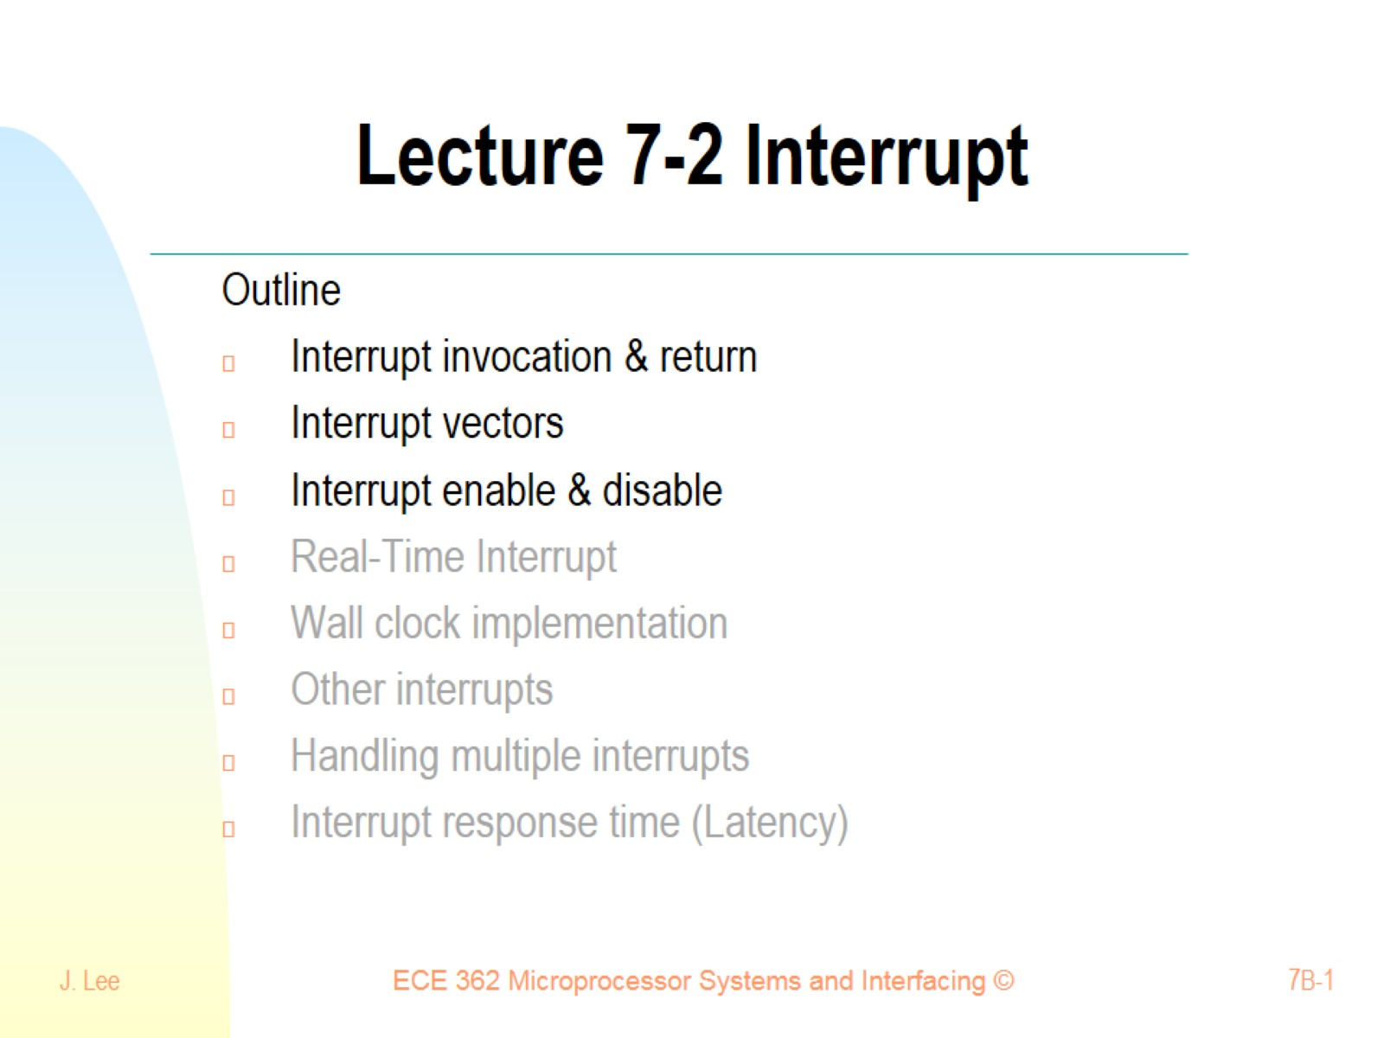
Lecture 7-2 Interrupt

Slide 2
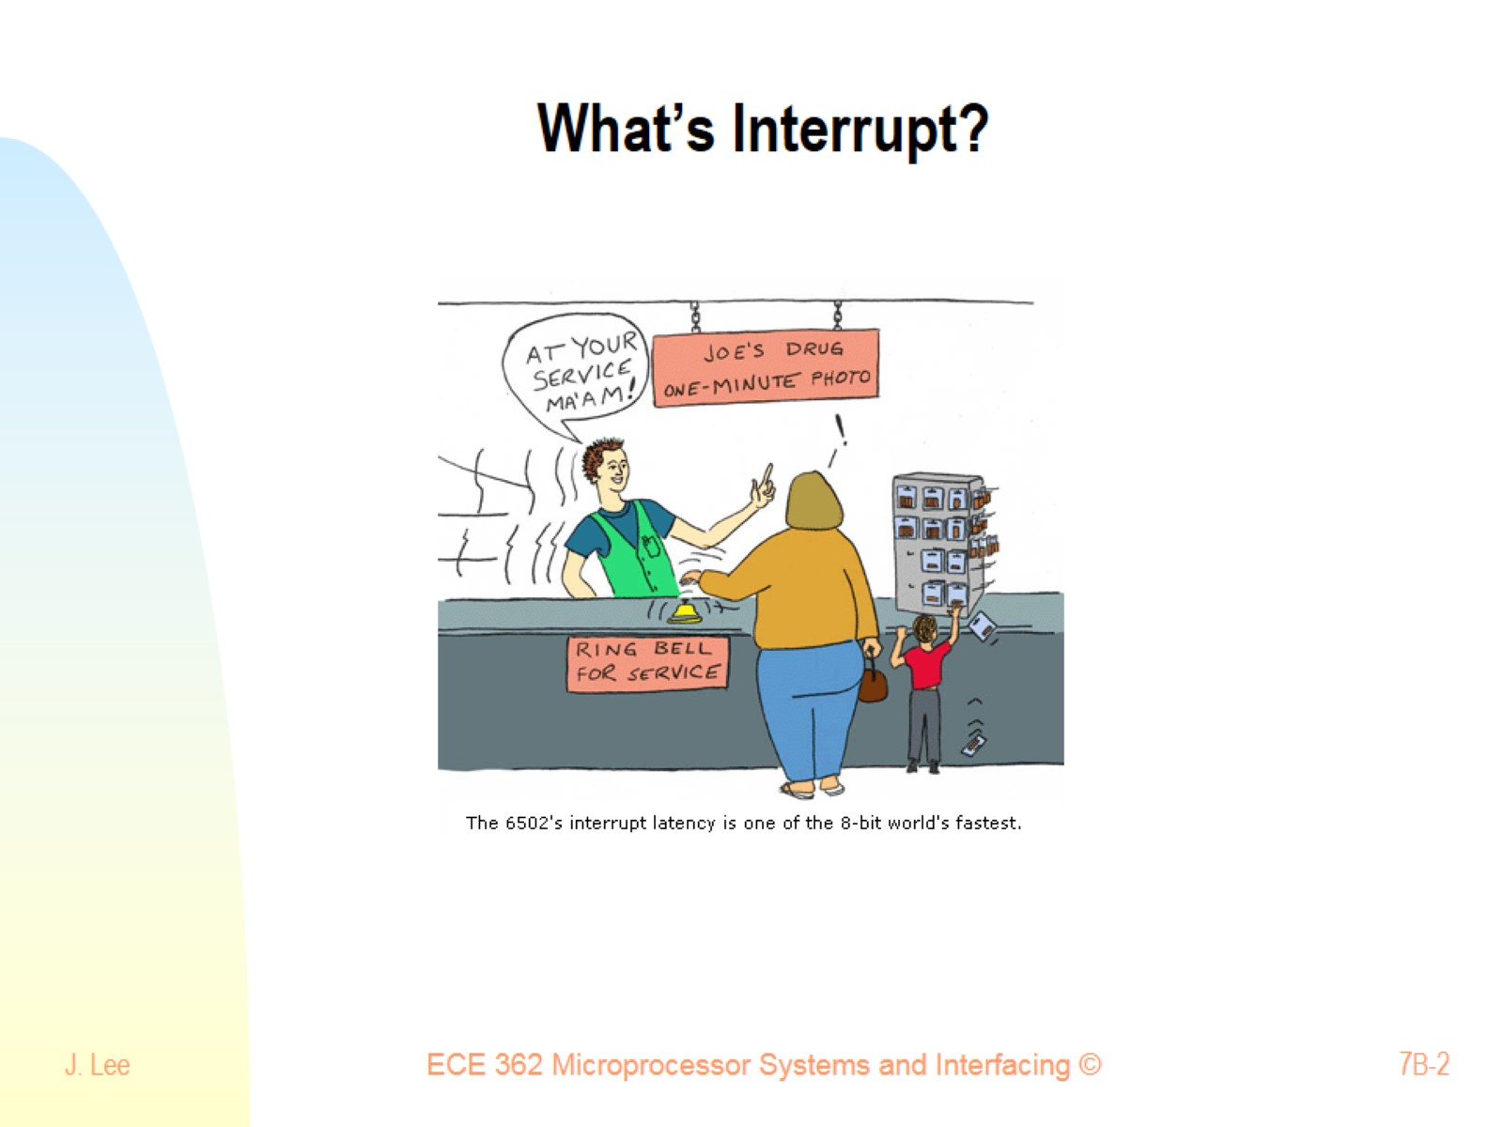
What’s Interrupt?

Slide 3
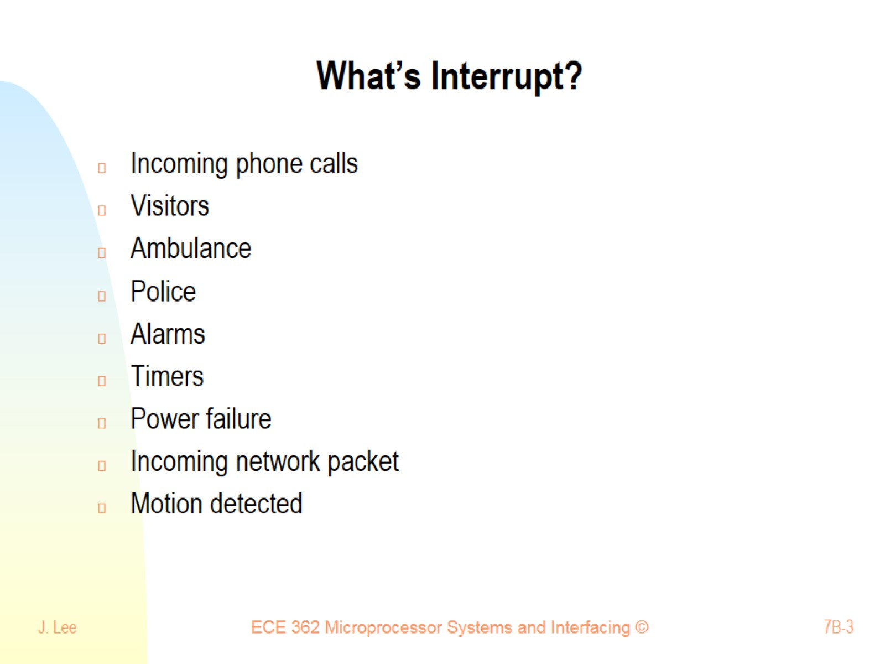
What’s Interrupt?

Slide 4
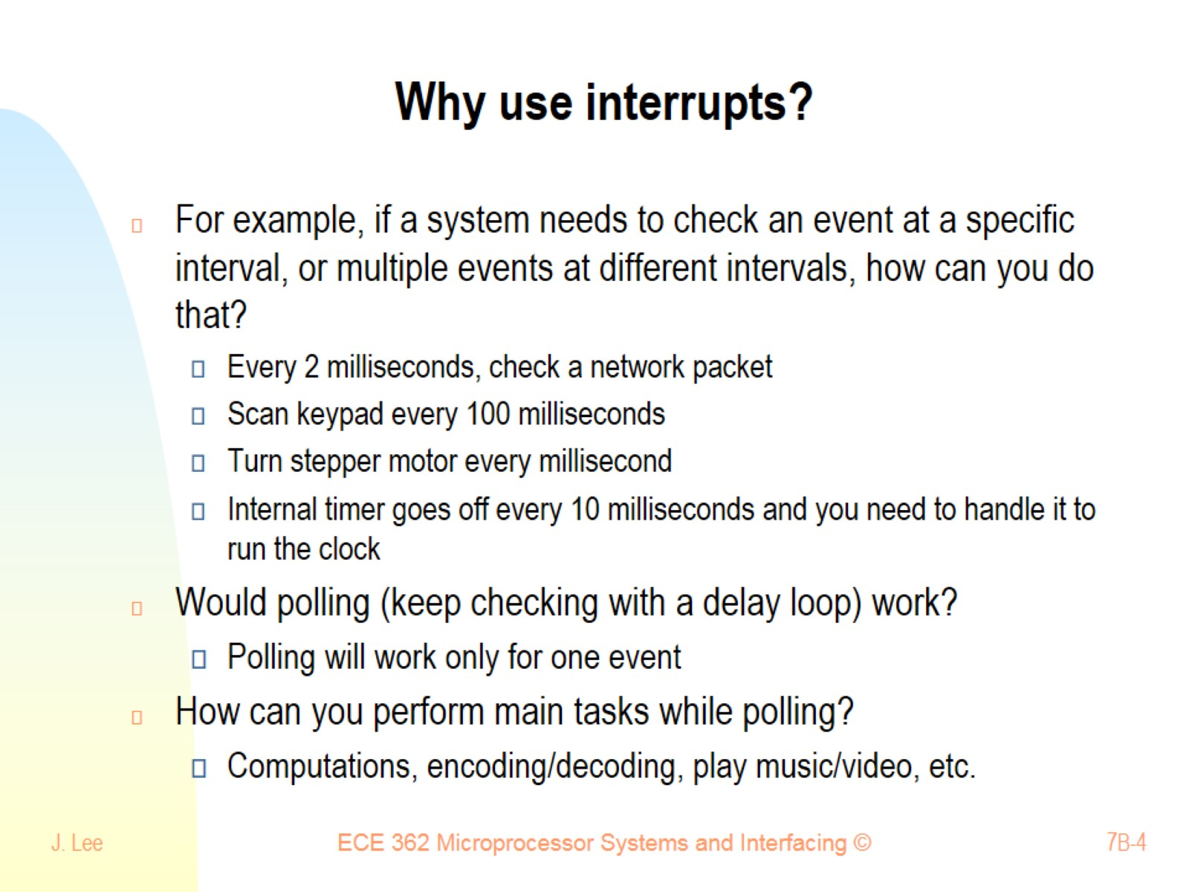
Why use interrupts?

Slide 5
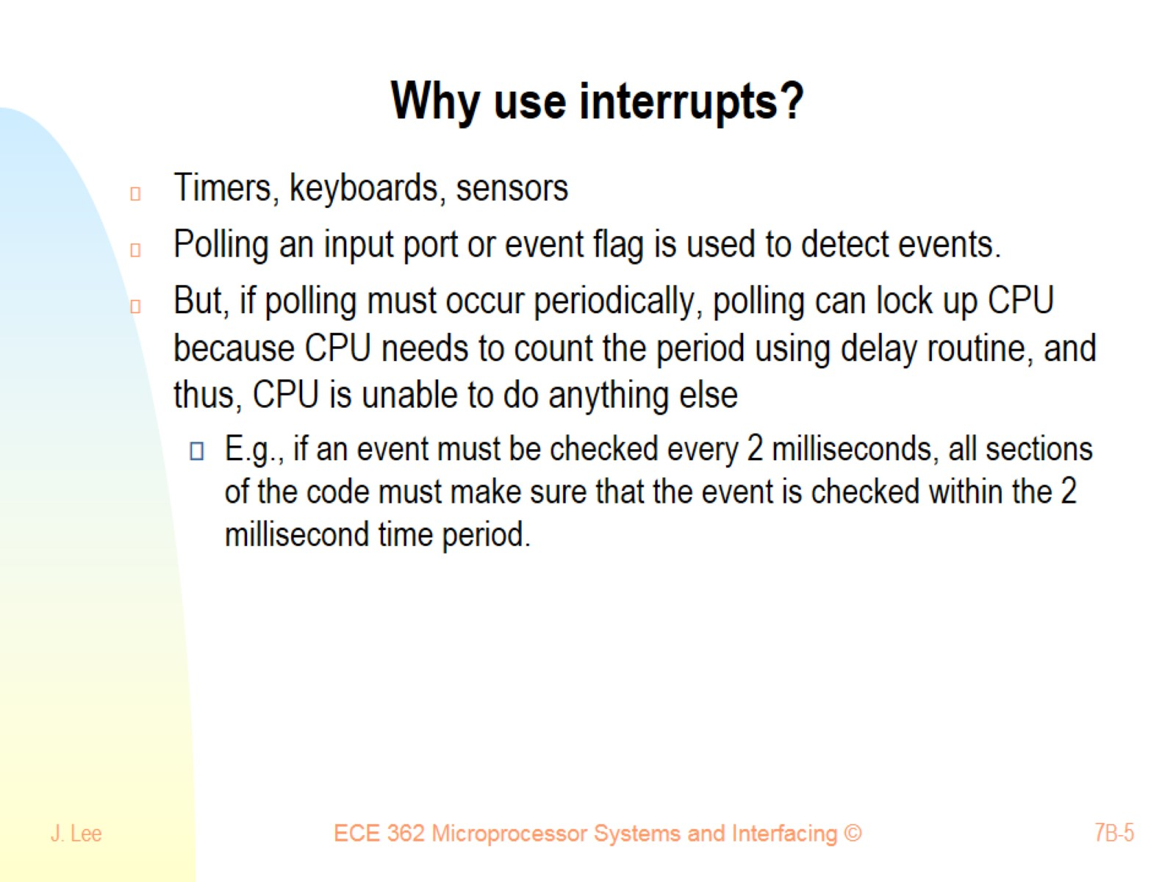
Why use interrupts?

Slide 6
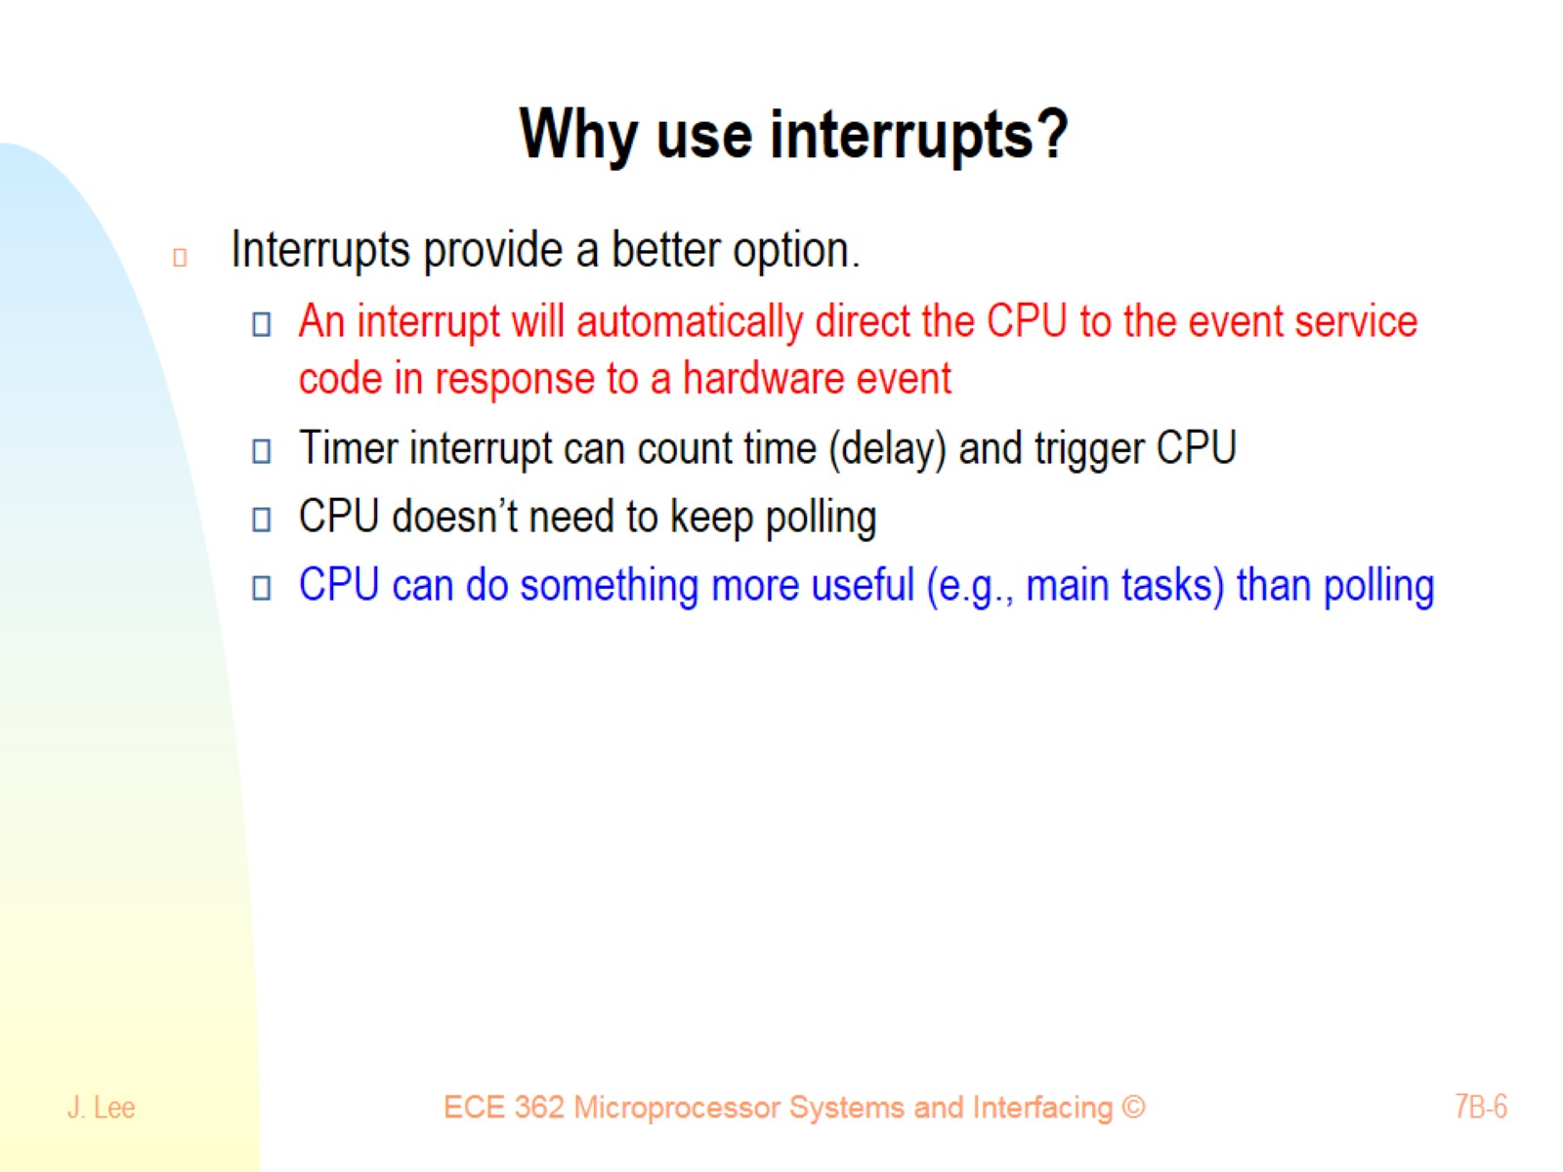
Why use interrupts?

Slide 7
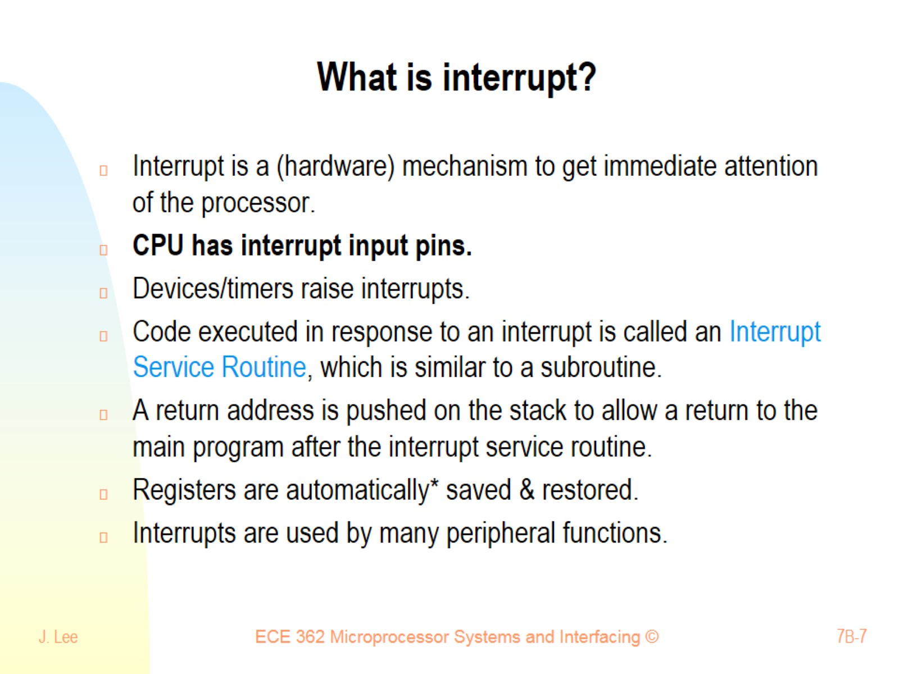
What is interrupt?

Slide 8
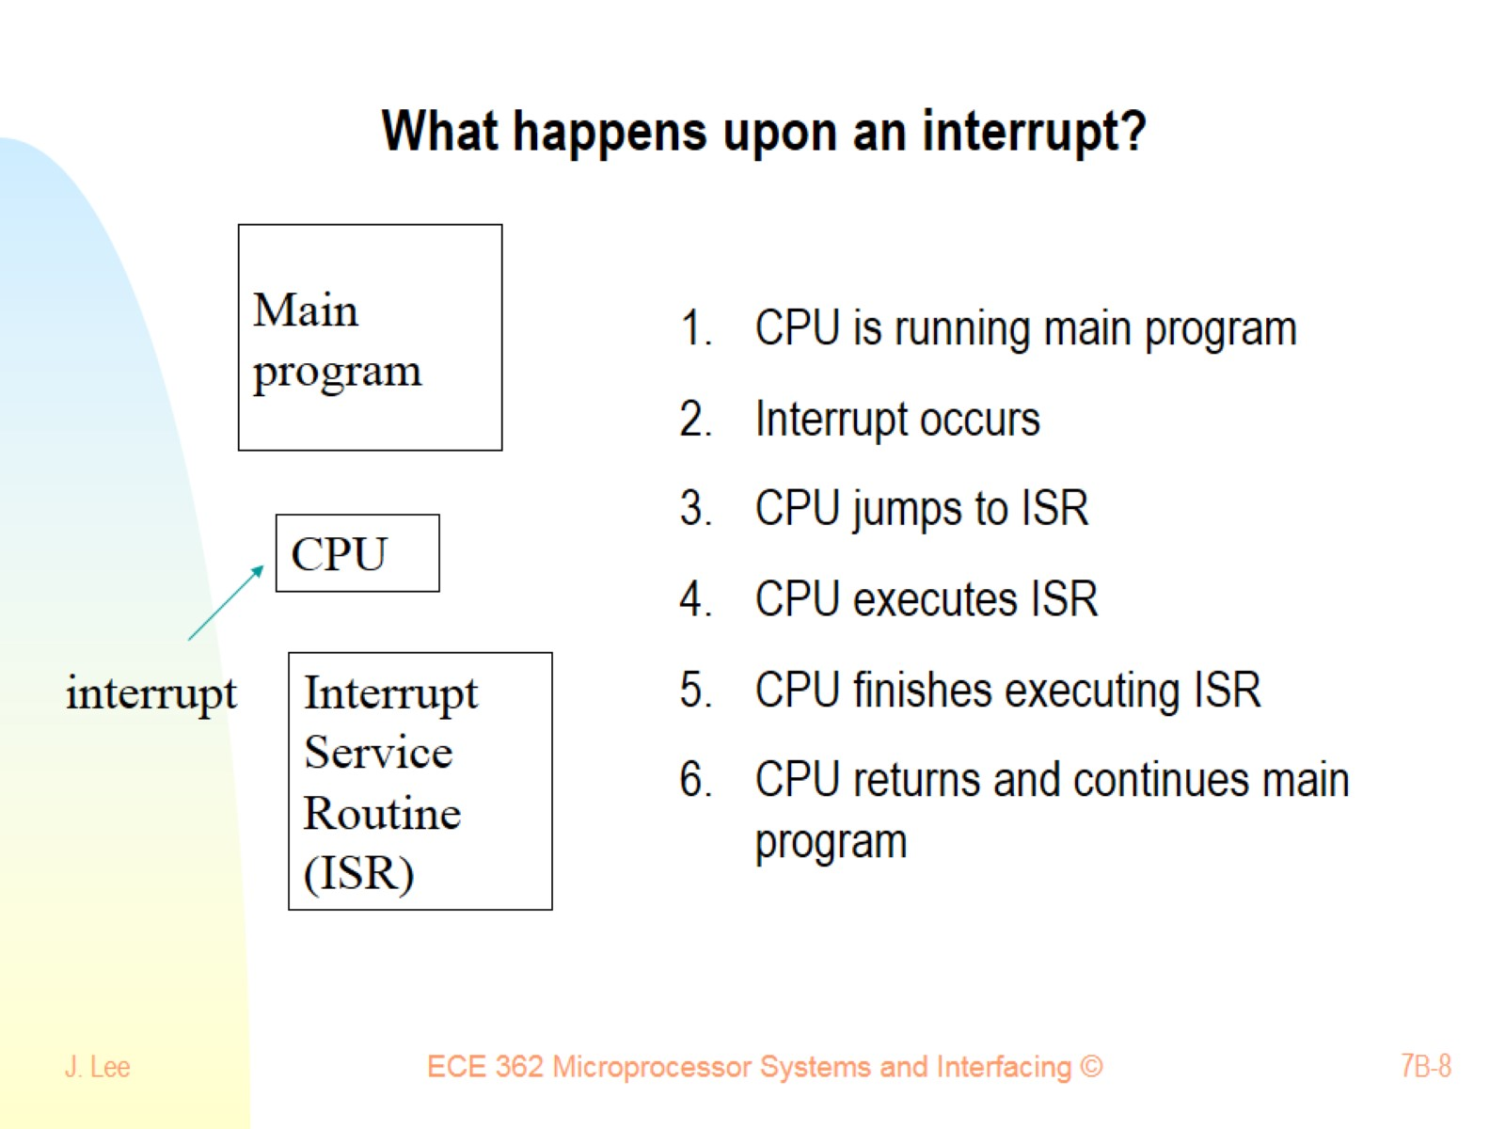
What happens upon an interrupt?

Slide 9
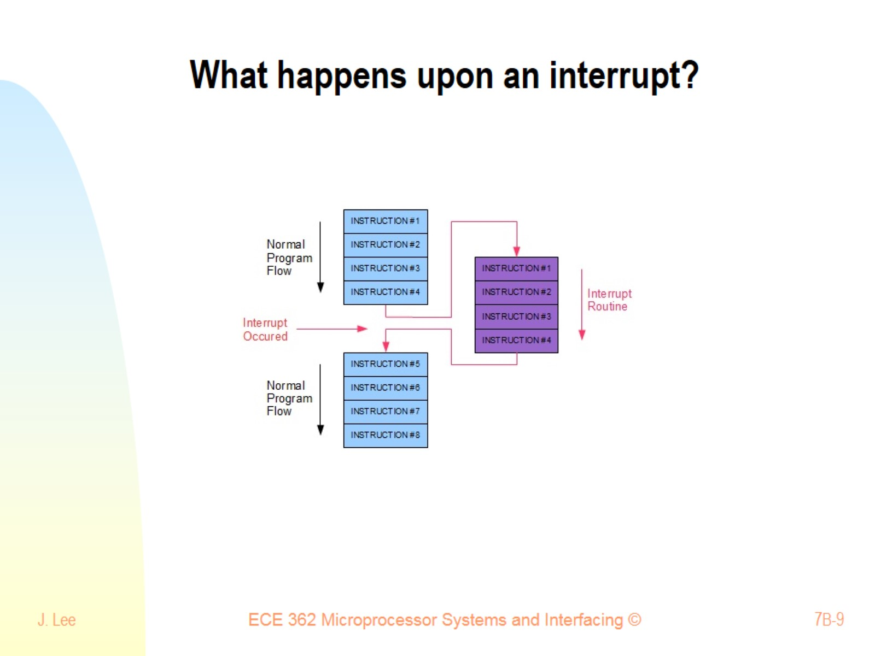
What happens upon an interrupt?

Slide 10
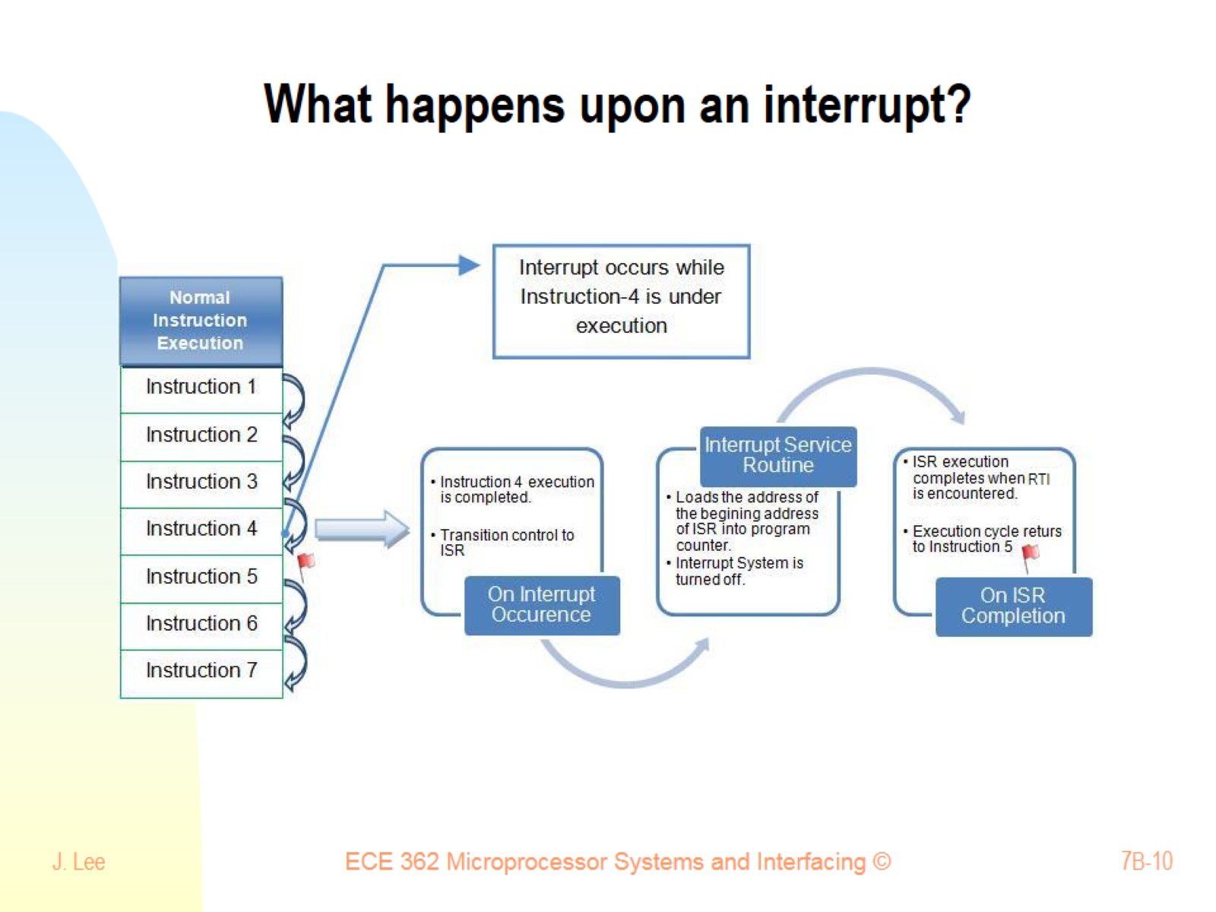
What happens upon an interrupt?

Slide 11
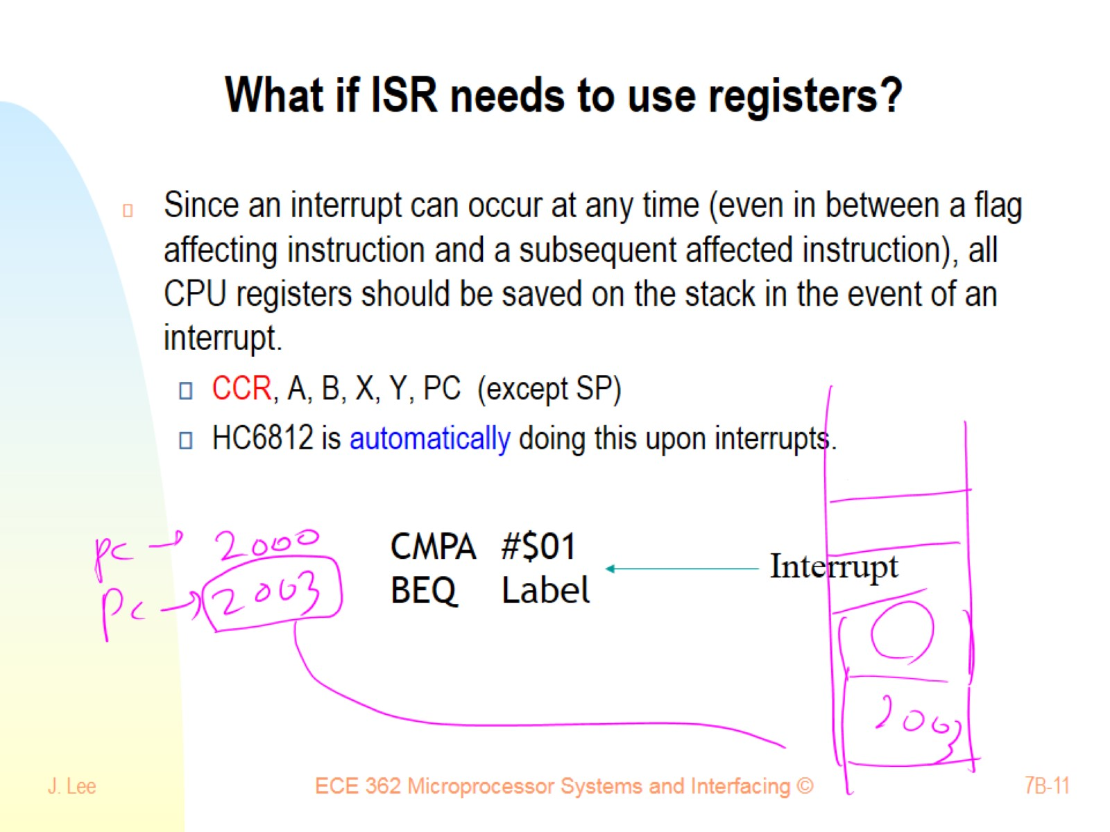
What if ISR needs to use registers?

Slide 12
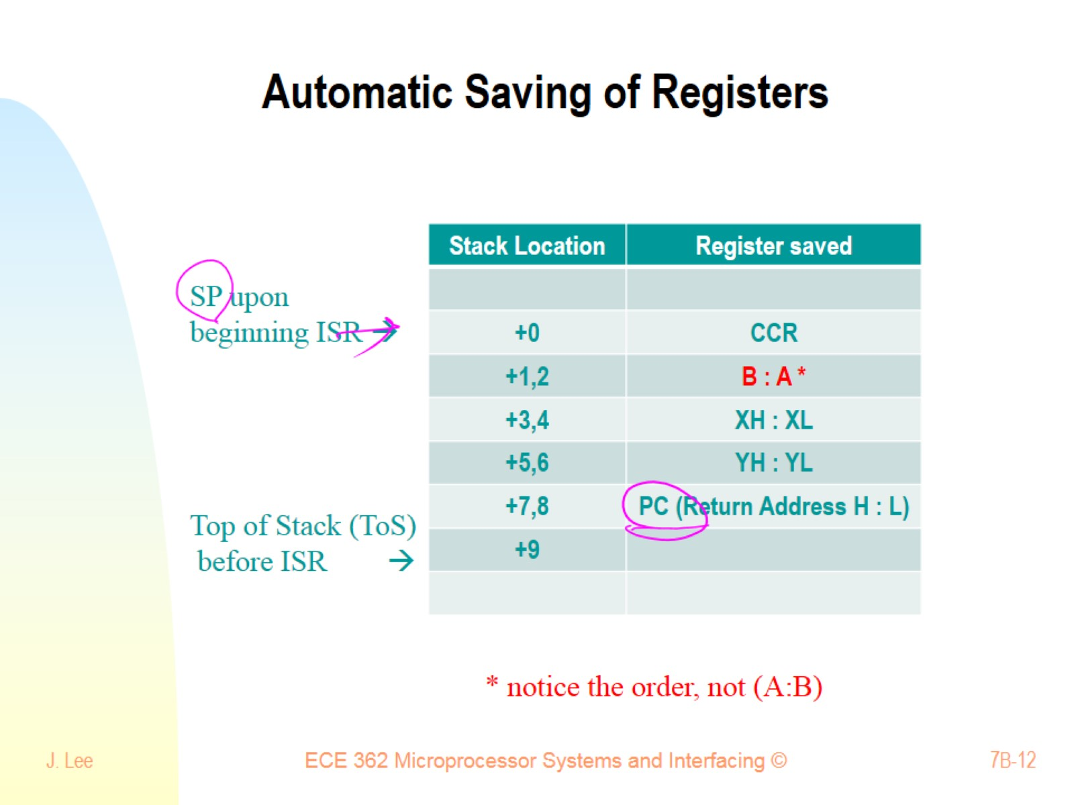
Automatic Saving of Registers

Slide 13
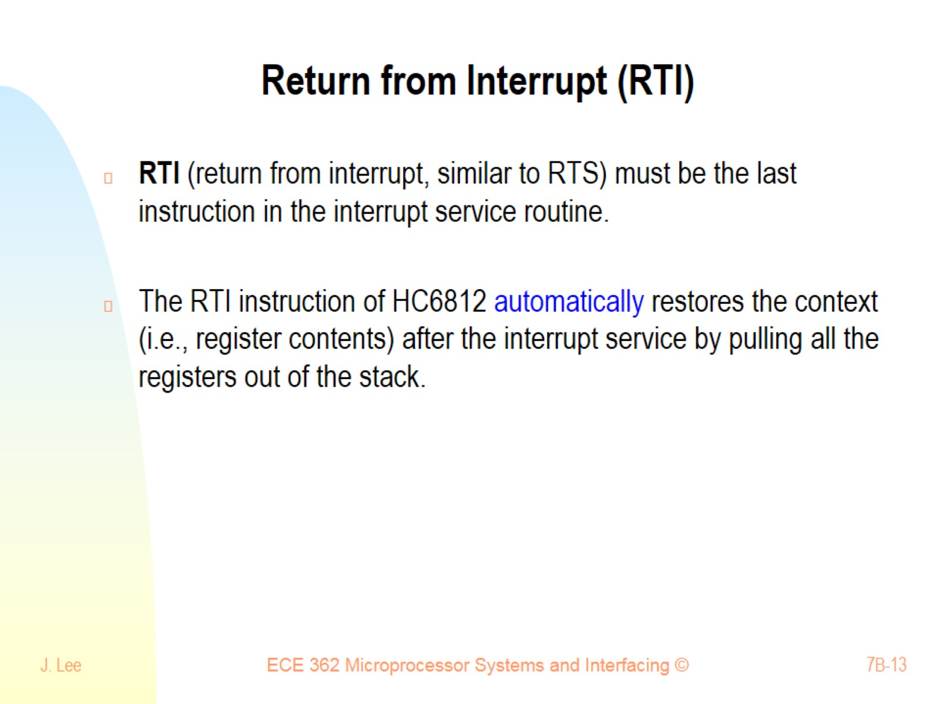
Return from Interrupt (RTI)

Slide 14
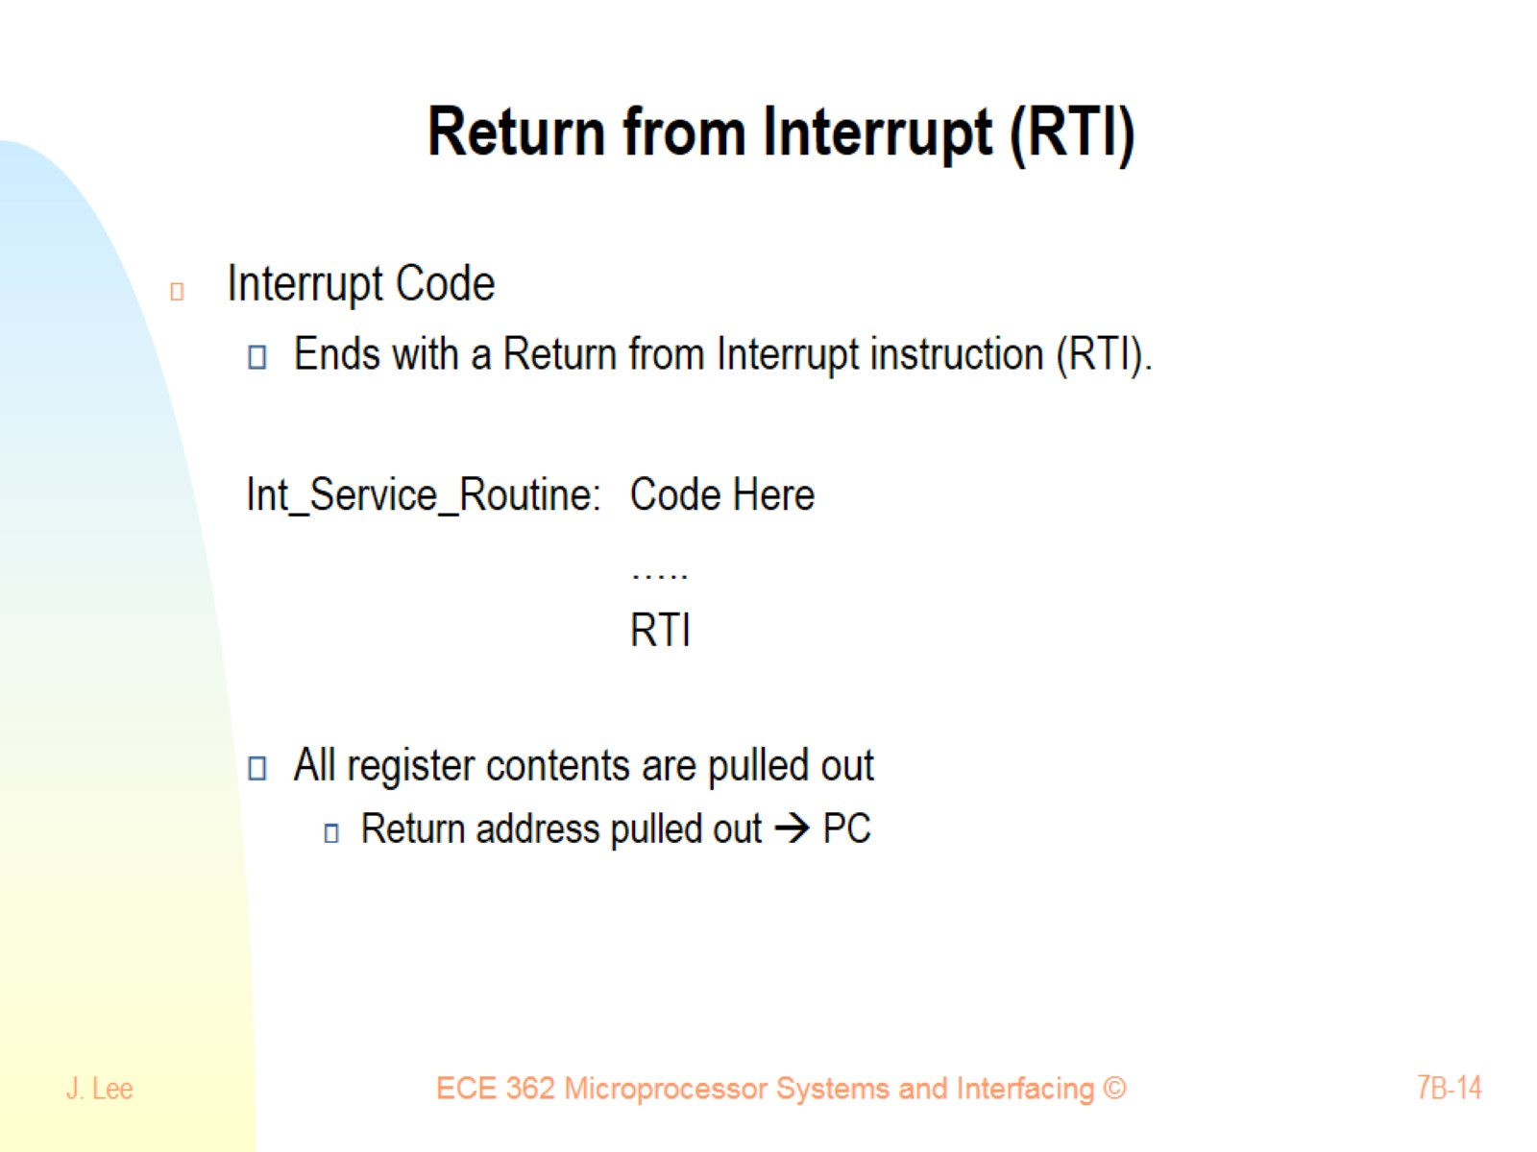
Return from Interrupt (RTI)

Slide 15
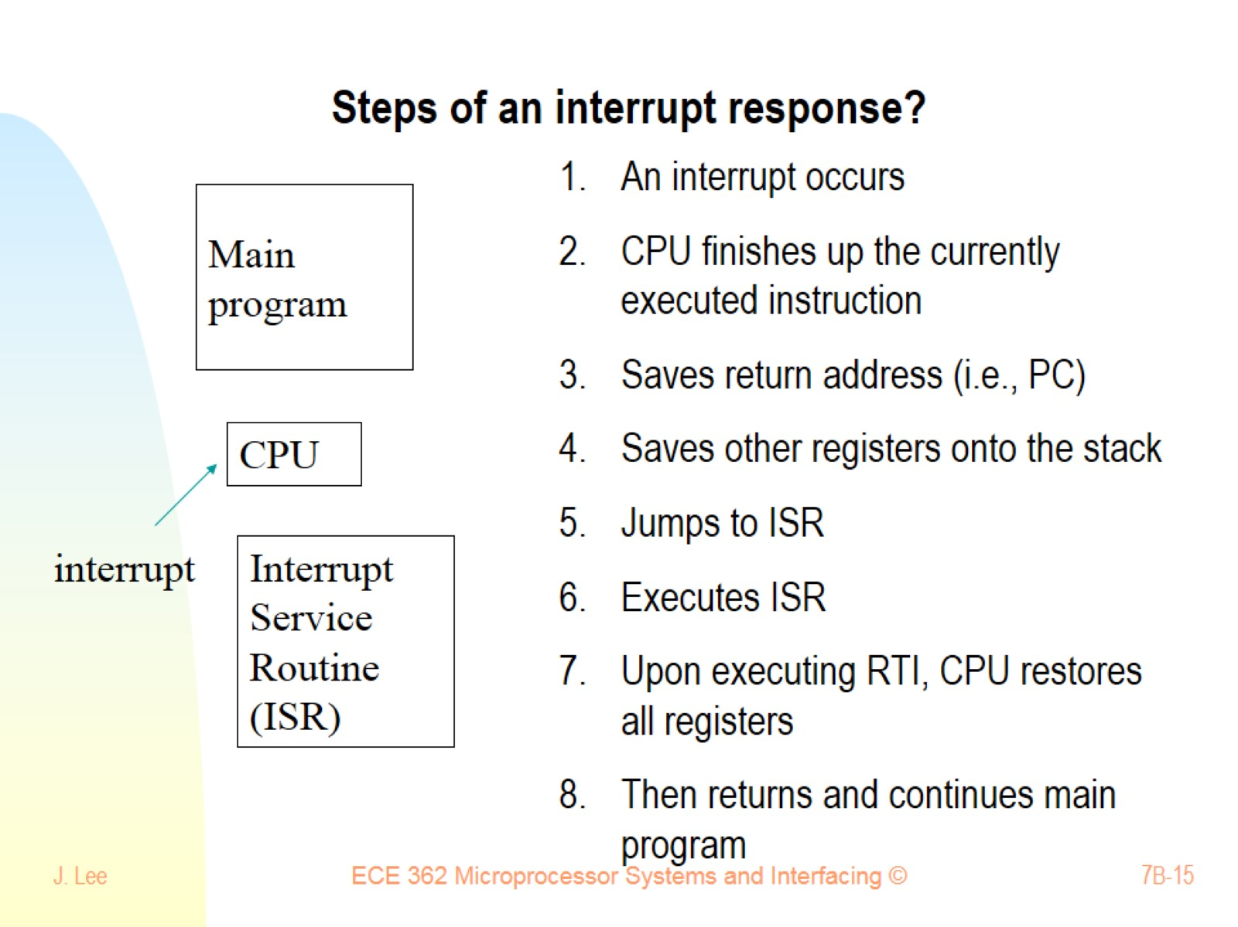
Steps of an interrupt response?

Slide 16
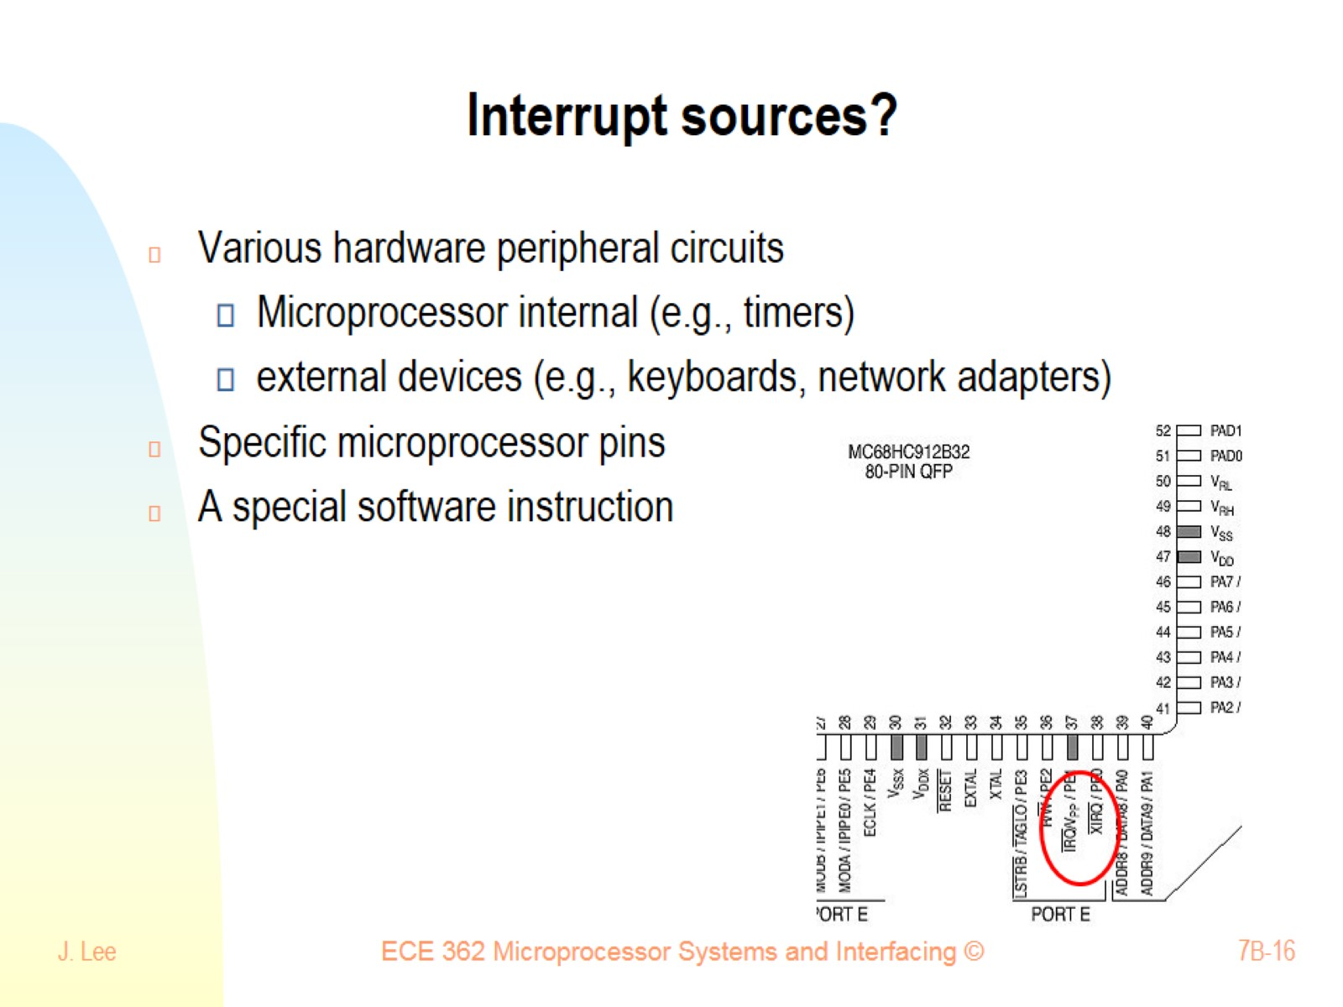
Interrupt sources?

Slide 17
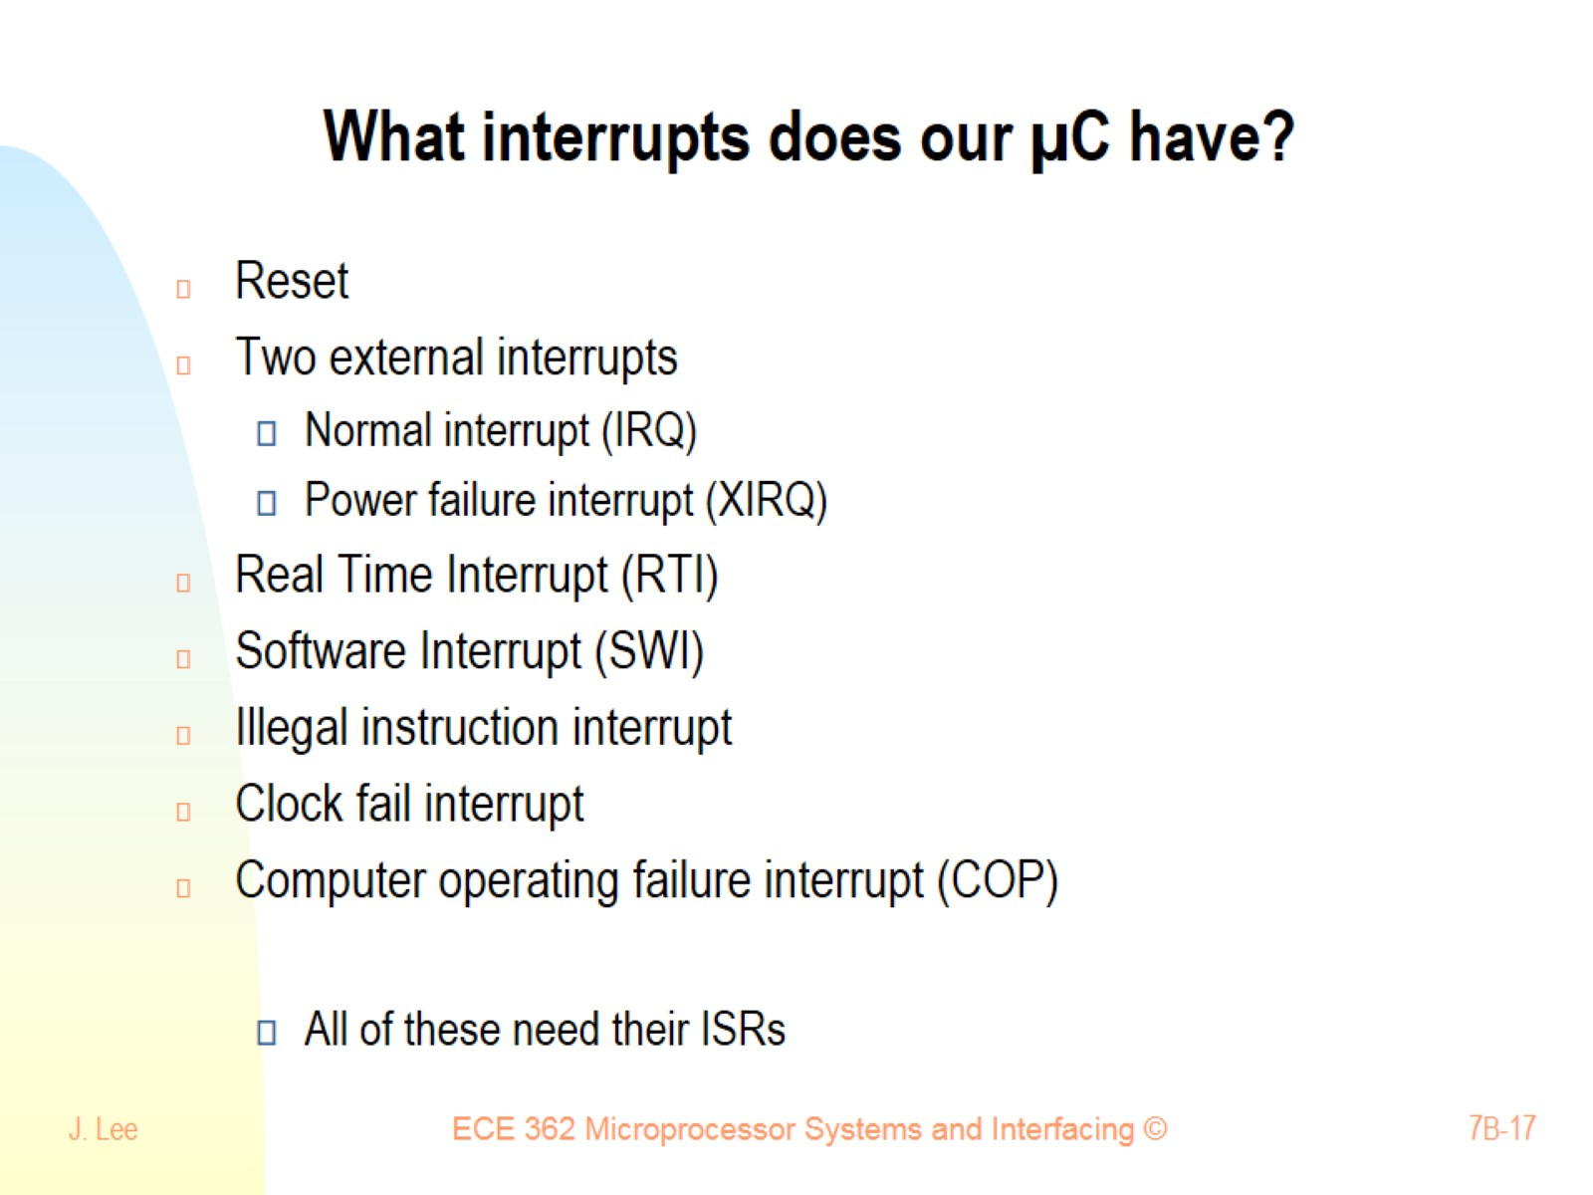
What interrupts does our µC have?

Slide 18
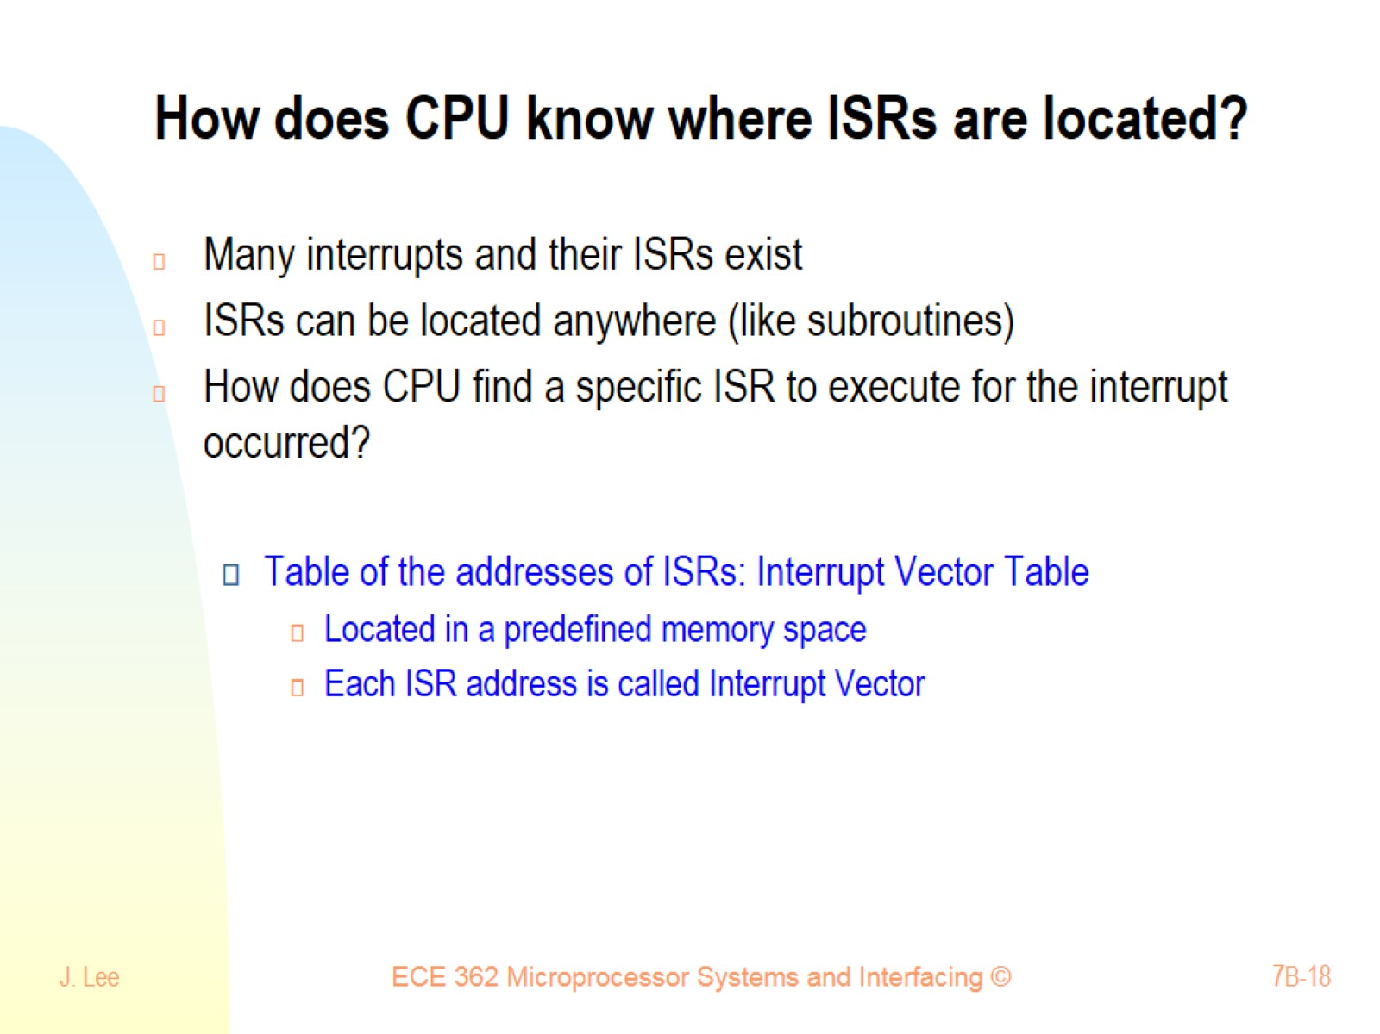
How does CPU know where ISRs are located?

Slide 19
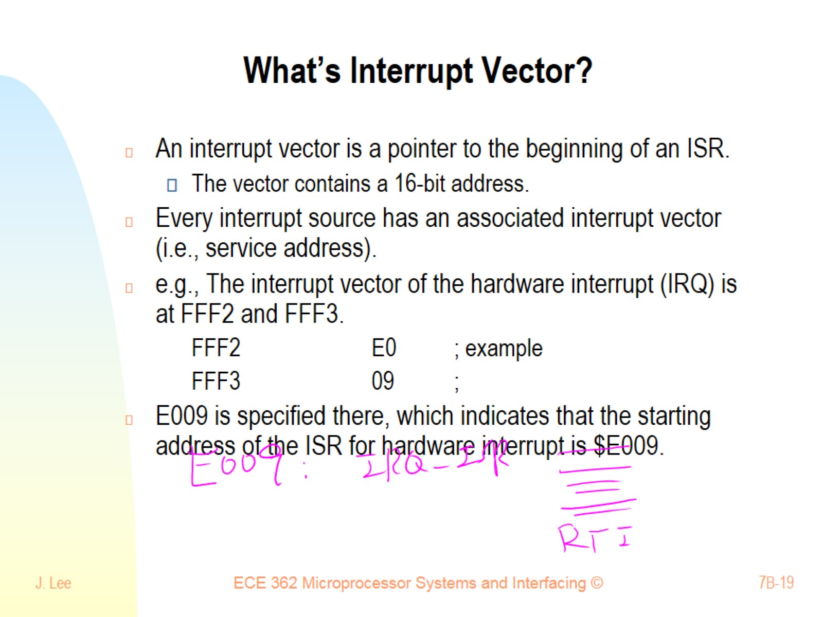
What’s Interrupt Vector?

Slide 20
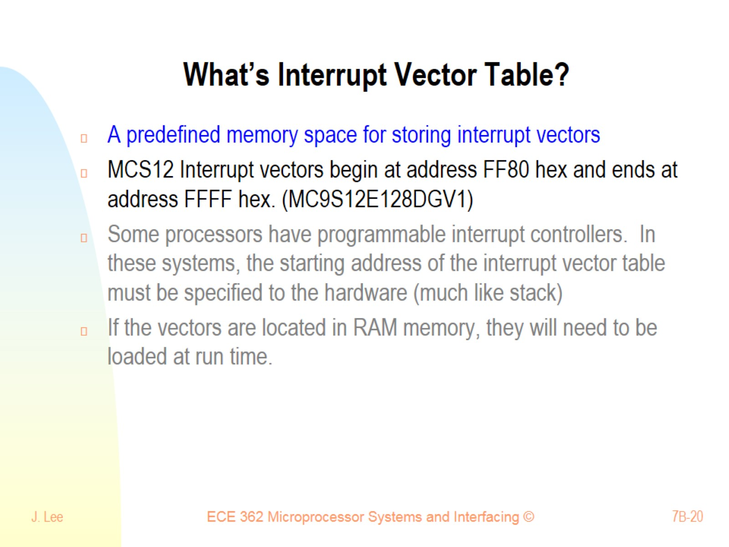
What’s Interrupt Vector Table?

Slide 21
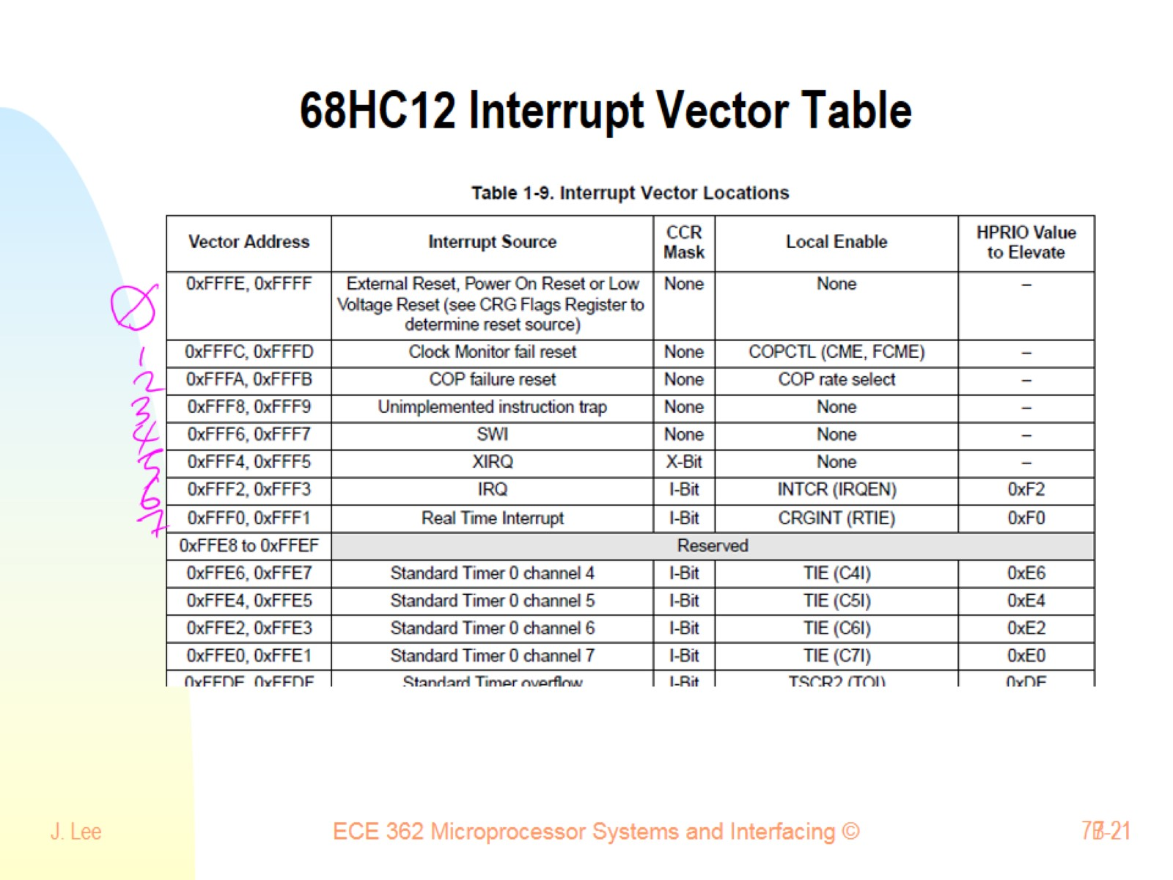
68HC12 Interrupt Vector Table

Slide 22
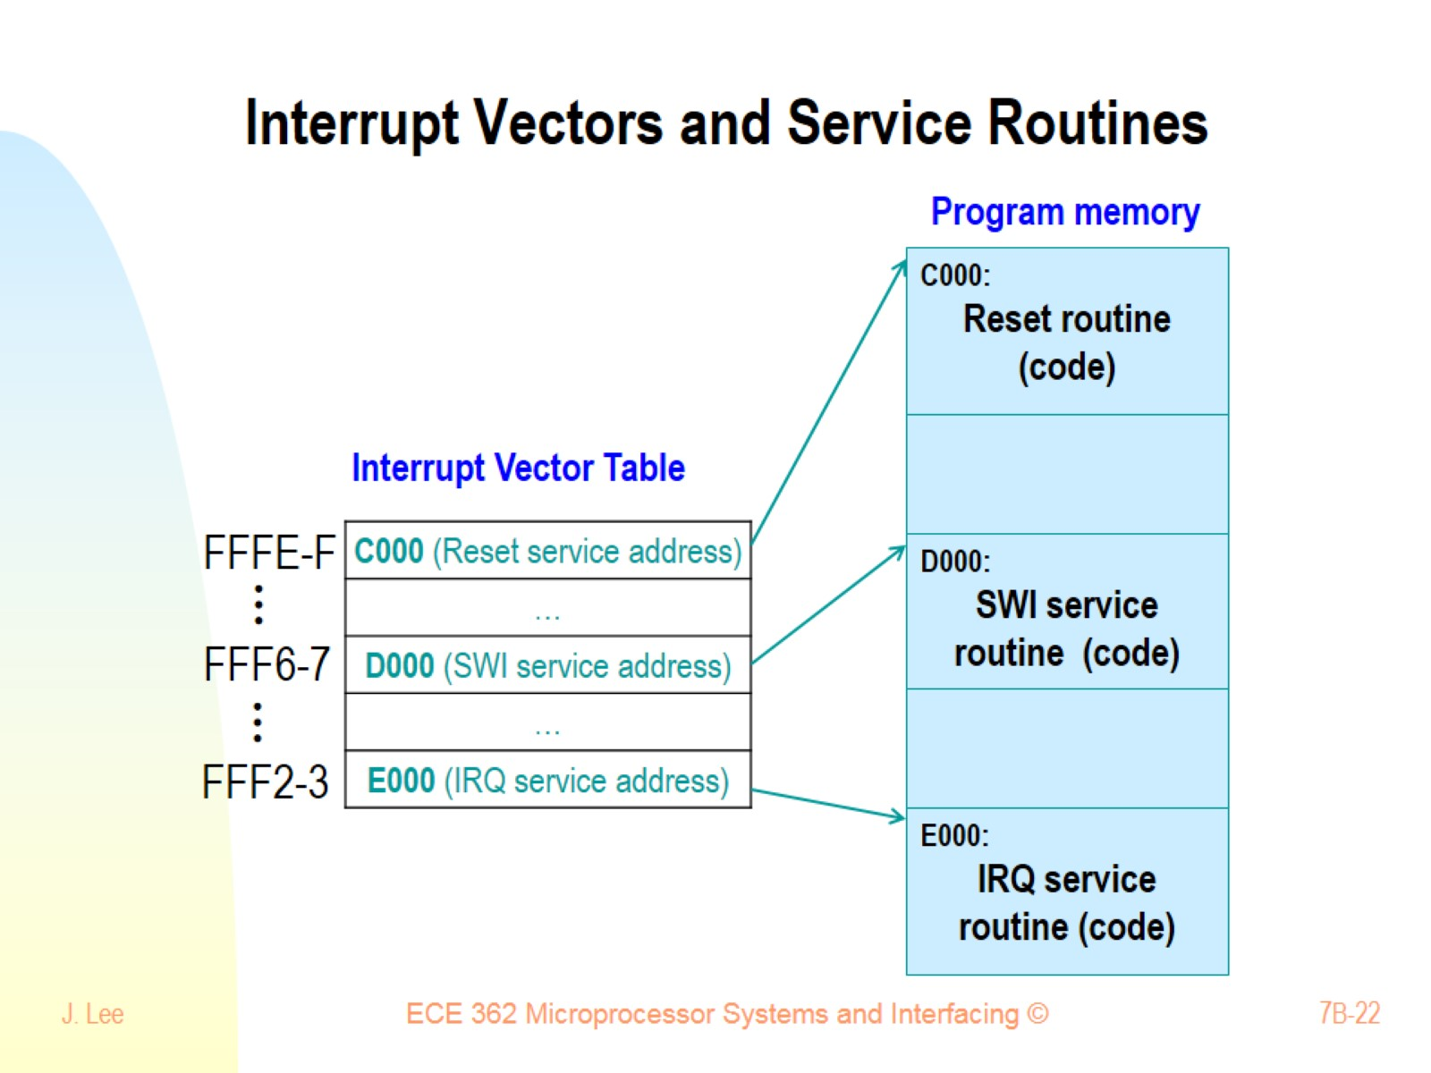
Interrupt Vectors and Service Routines

Slide 23
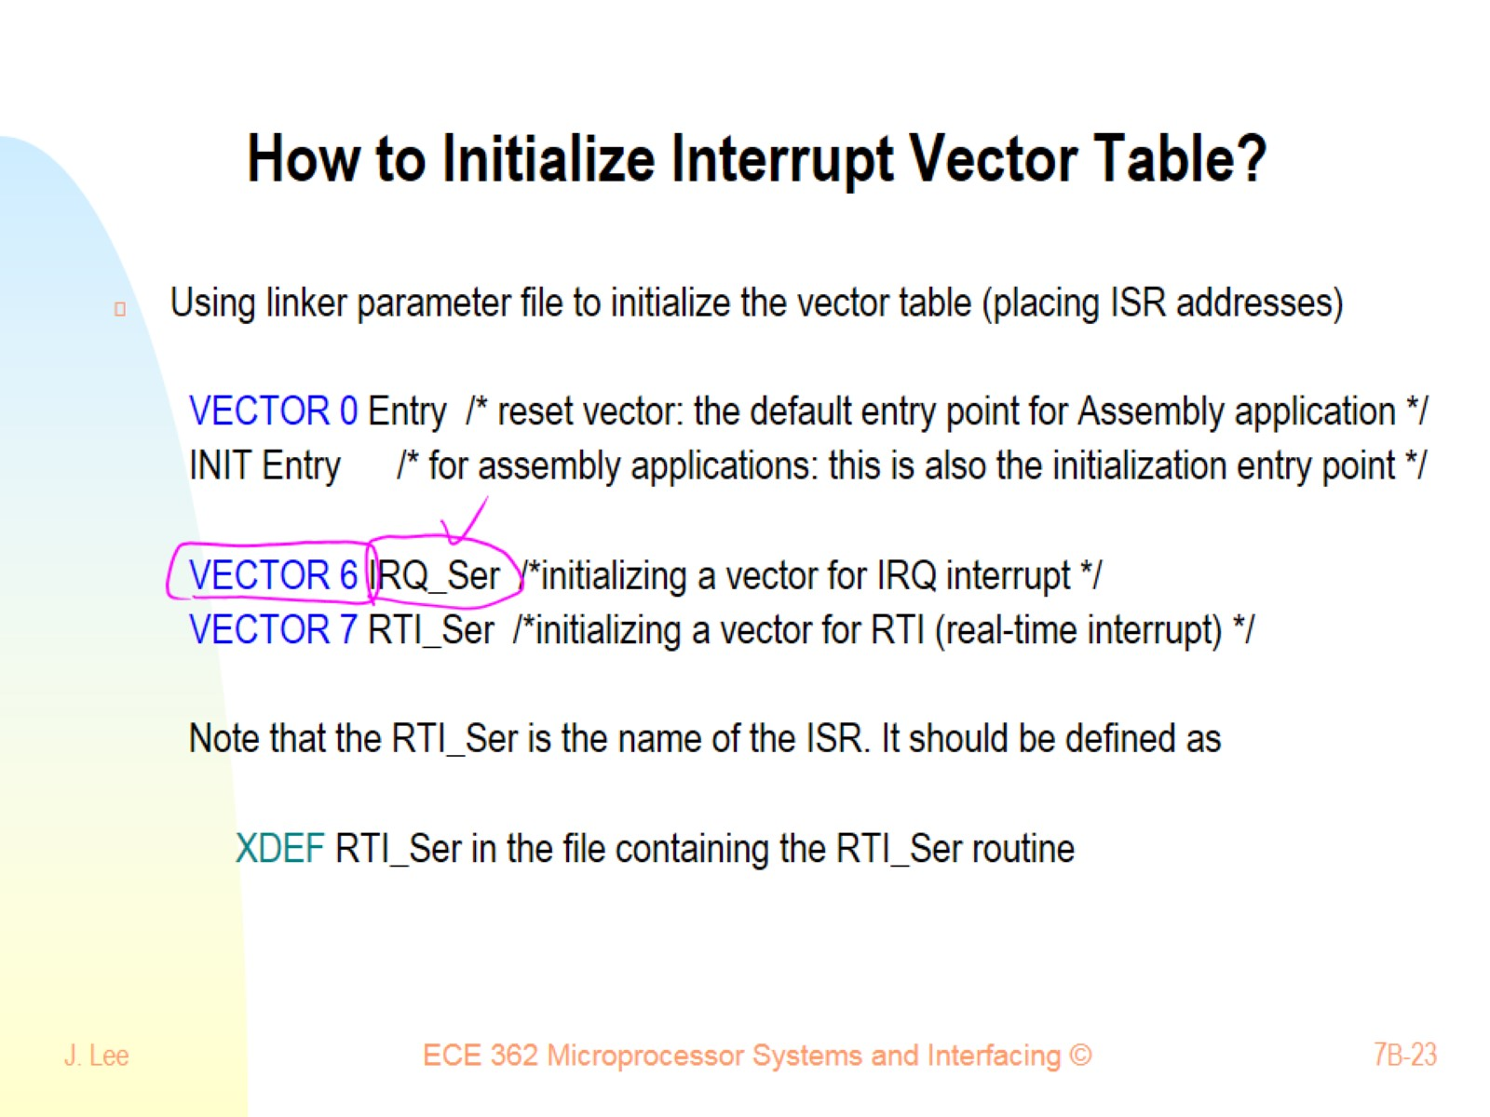
How to Initialize Interrupt Vector Table?

Slide 24
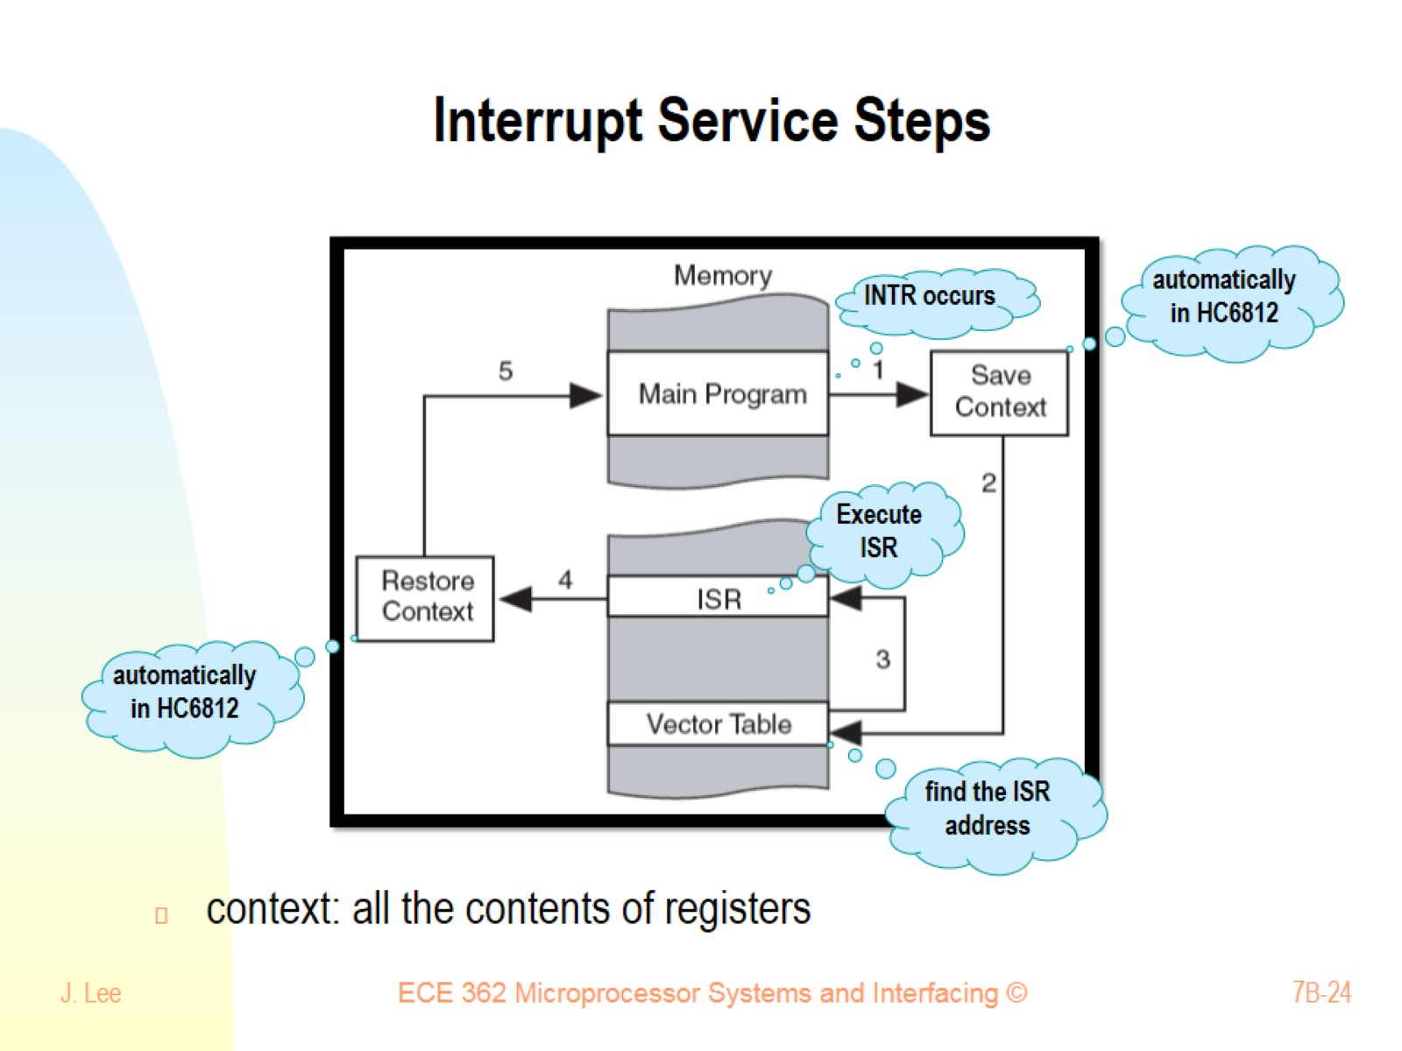
Interrupt Service Steps

Slide 25
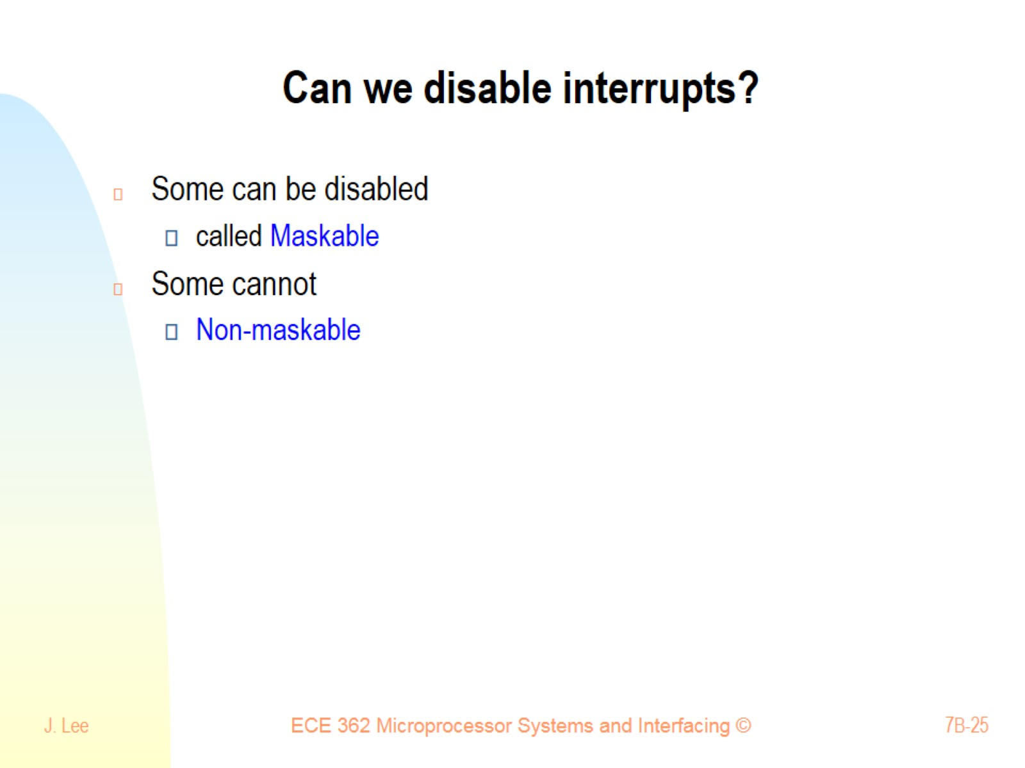
Can we disable interrupts?

Slide 26
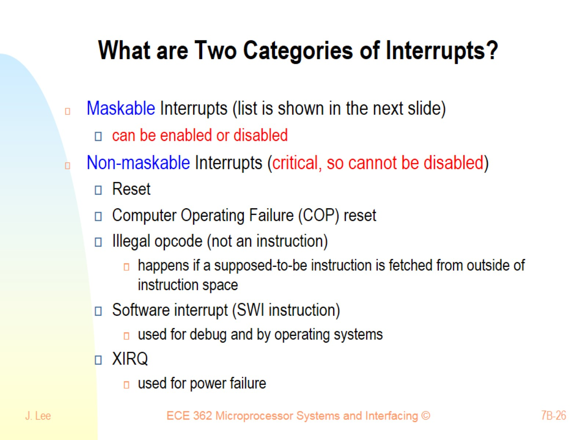
What are Two Categories of Interrupts?

Slide 27
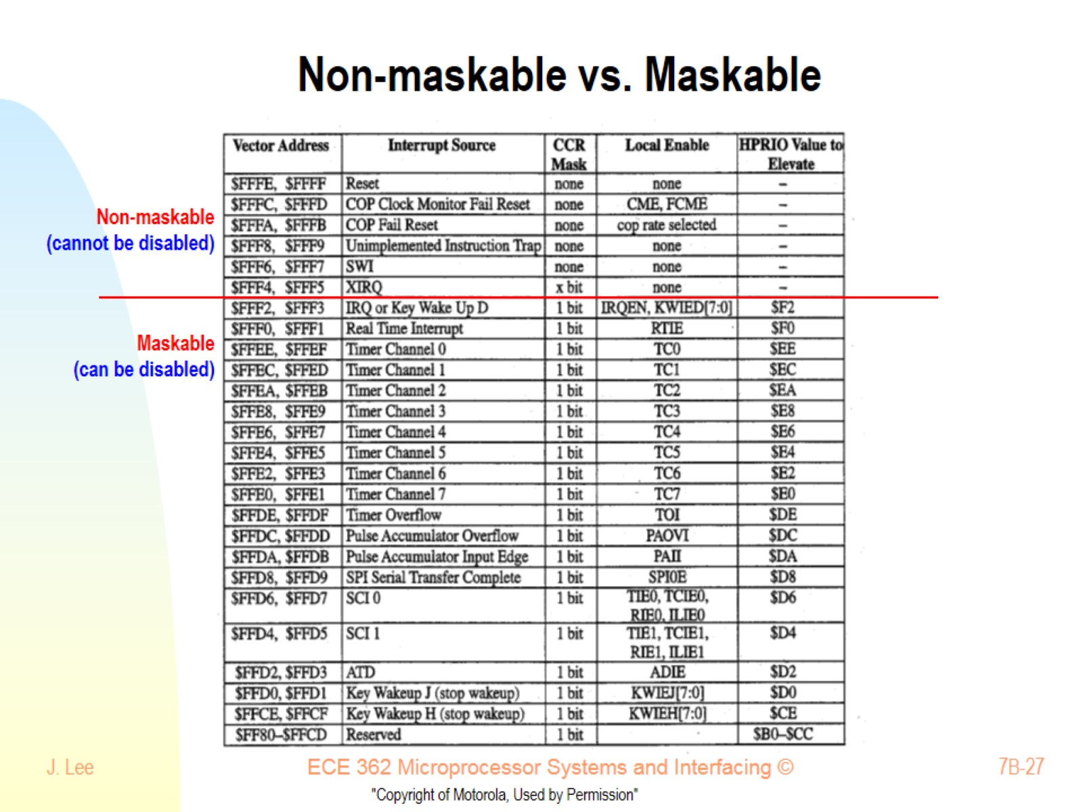
Non-maskable vs. Maskable

Slide 28
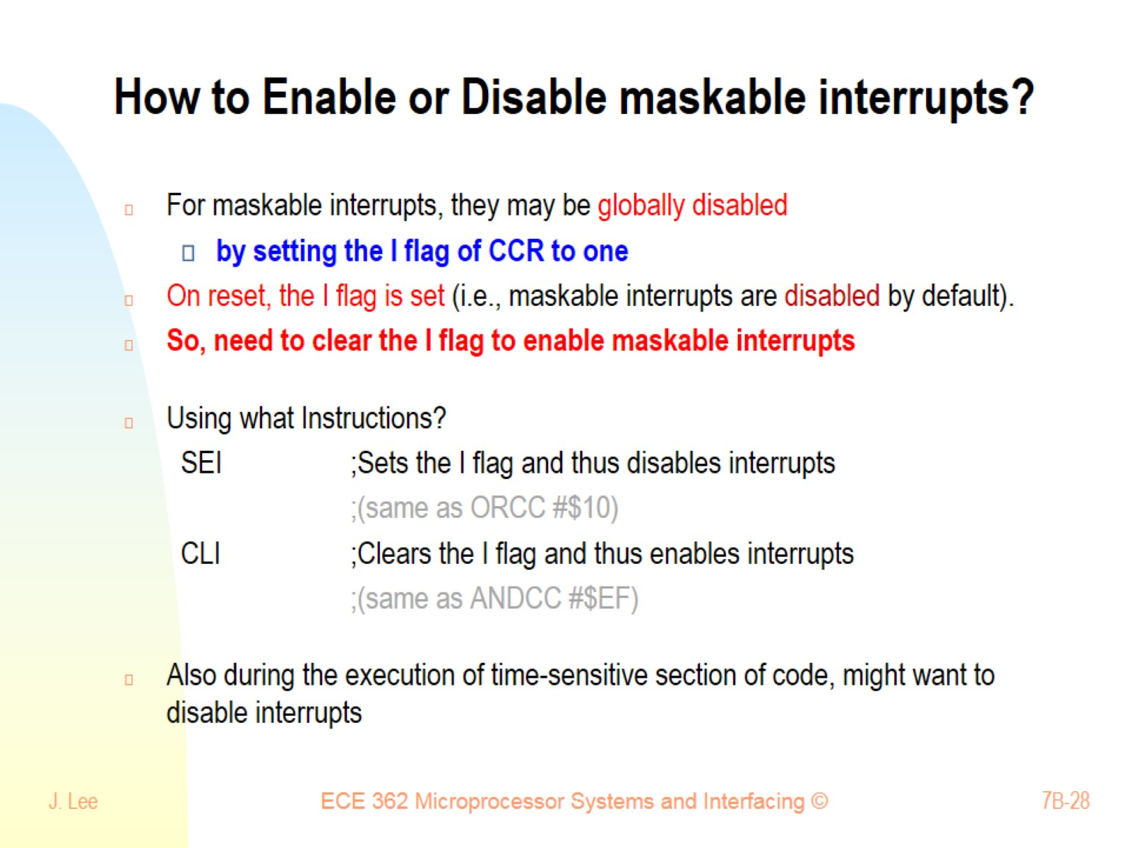
How to Enable or Disable maskable interrupts?

Slide 29
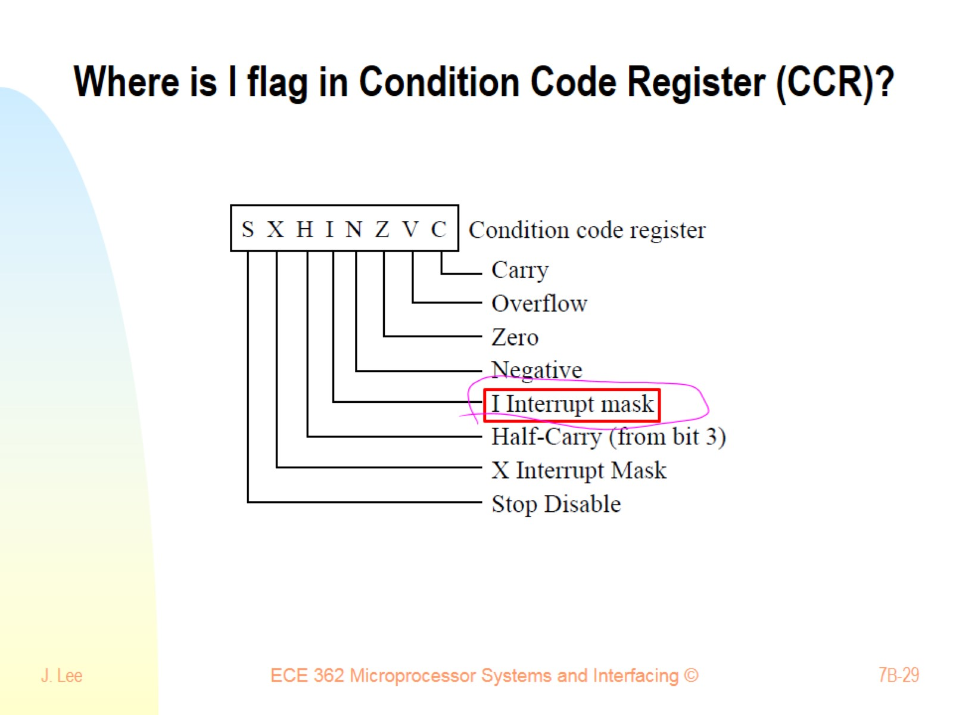
Where is I flag in Condition Code Register (CCR)?

Slide 30
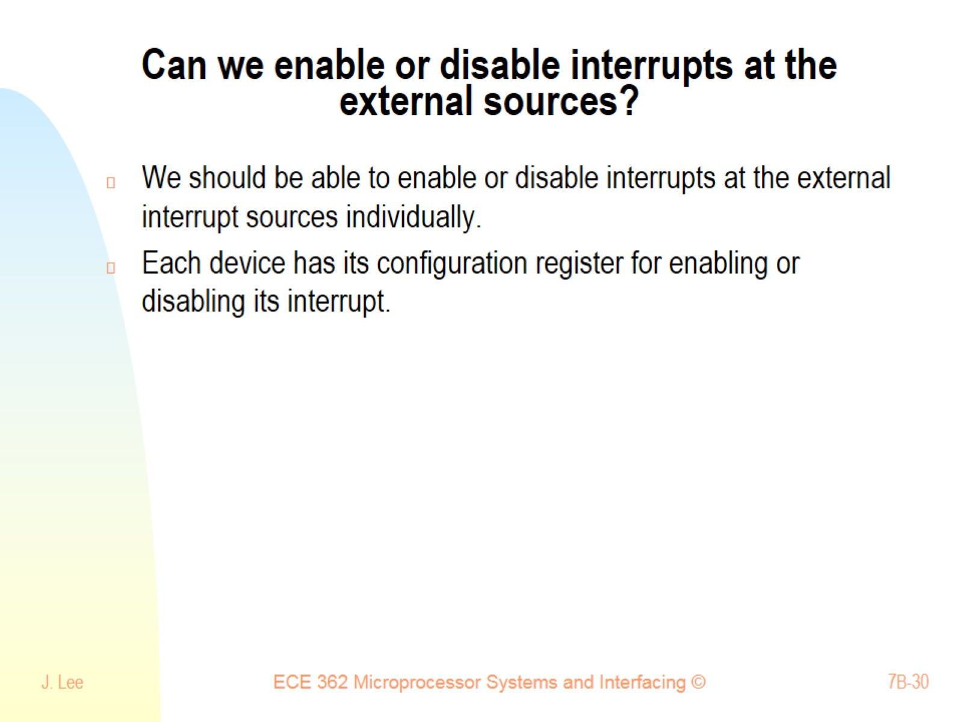
Can we enable or disable interrupts at the external sources?

Slide 31
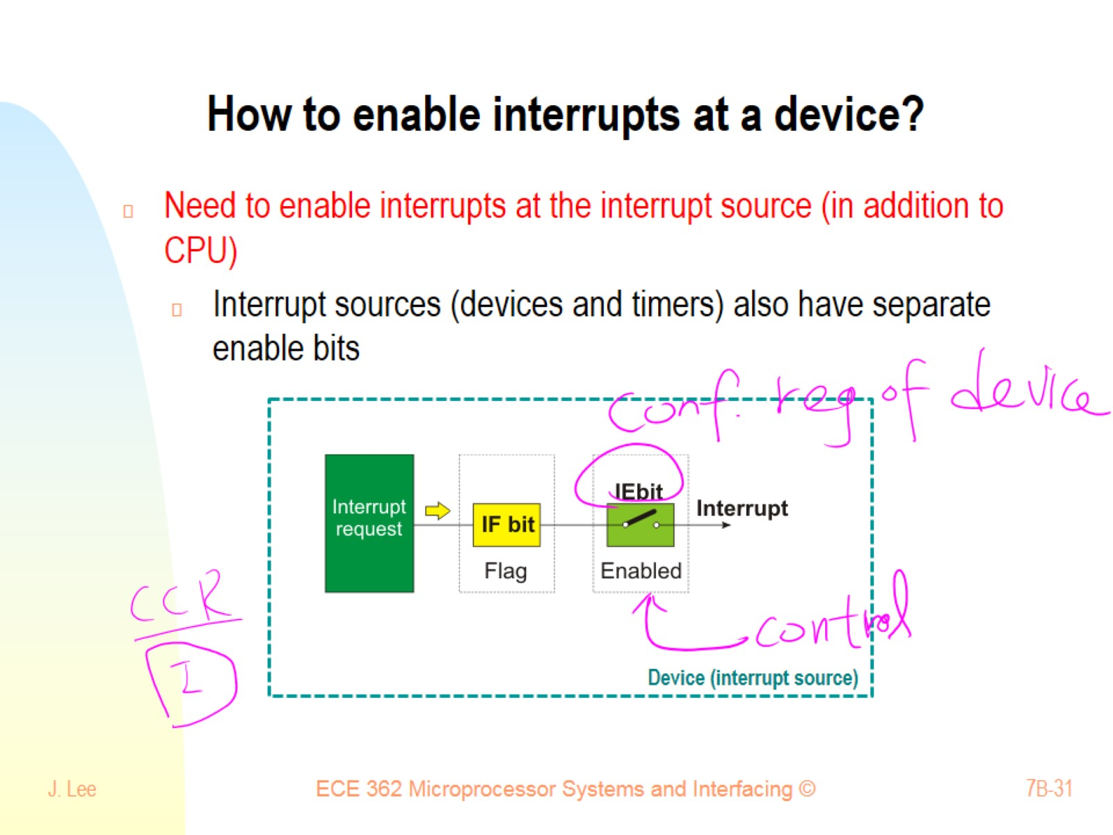
How to enable interrupts at a device?

Slide 32
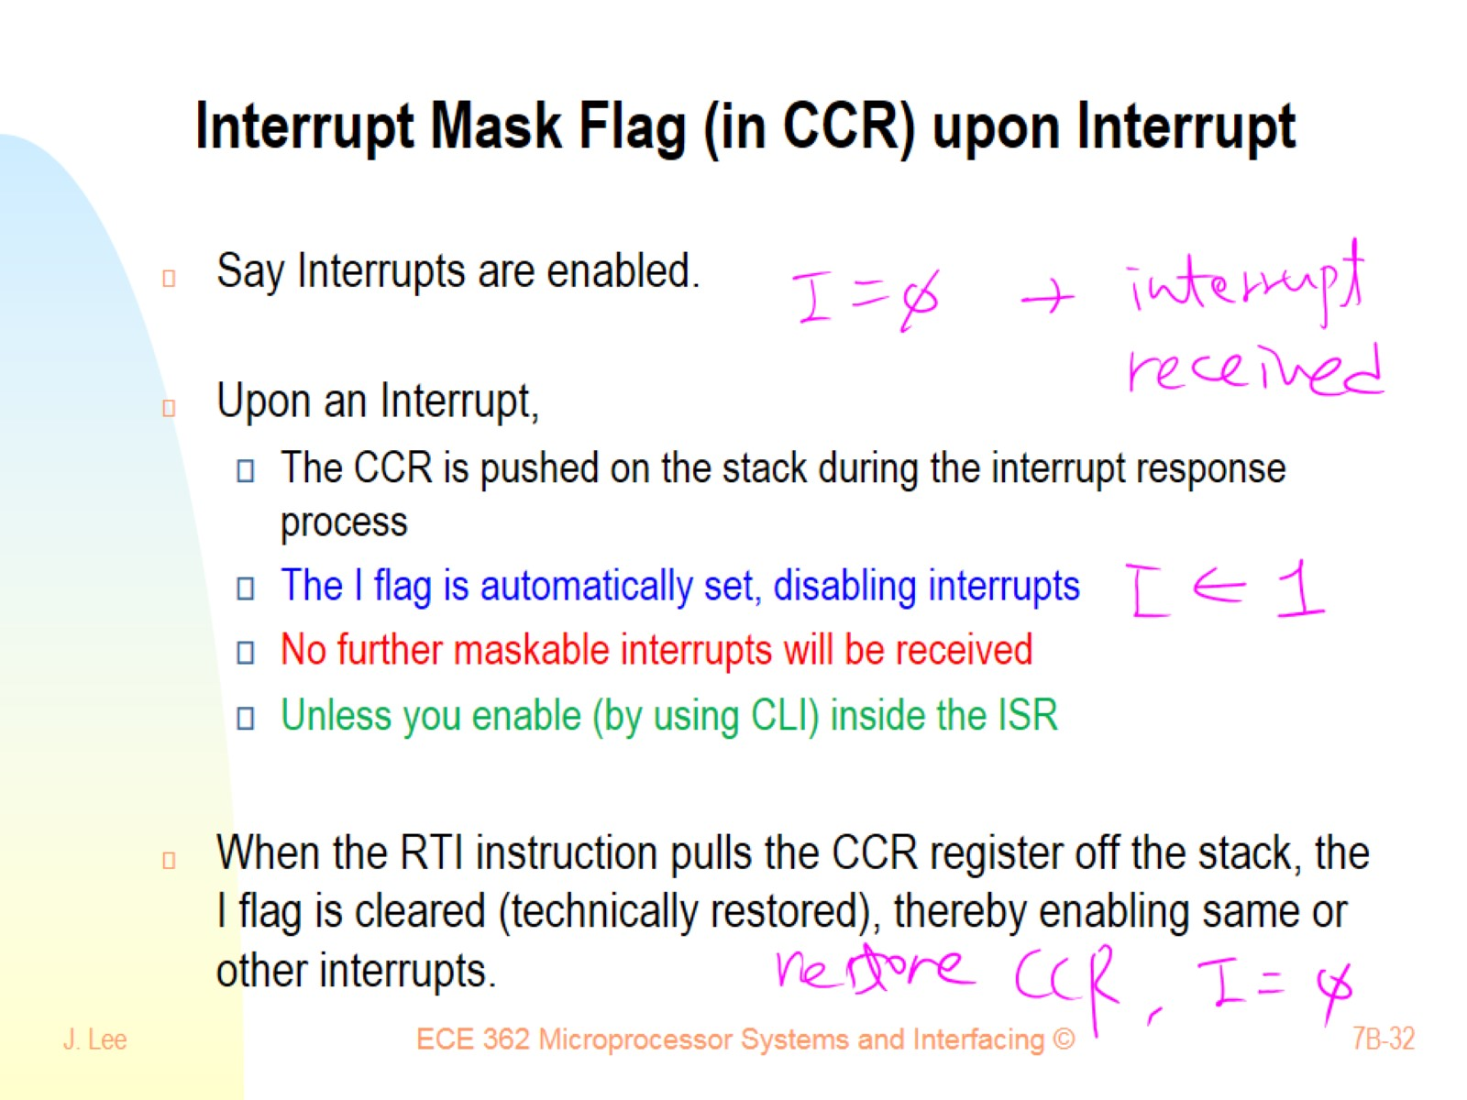
Interrupt Mask Flag (in CCR) upon Interrupt

Slide 33
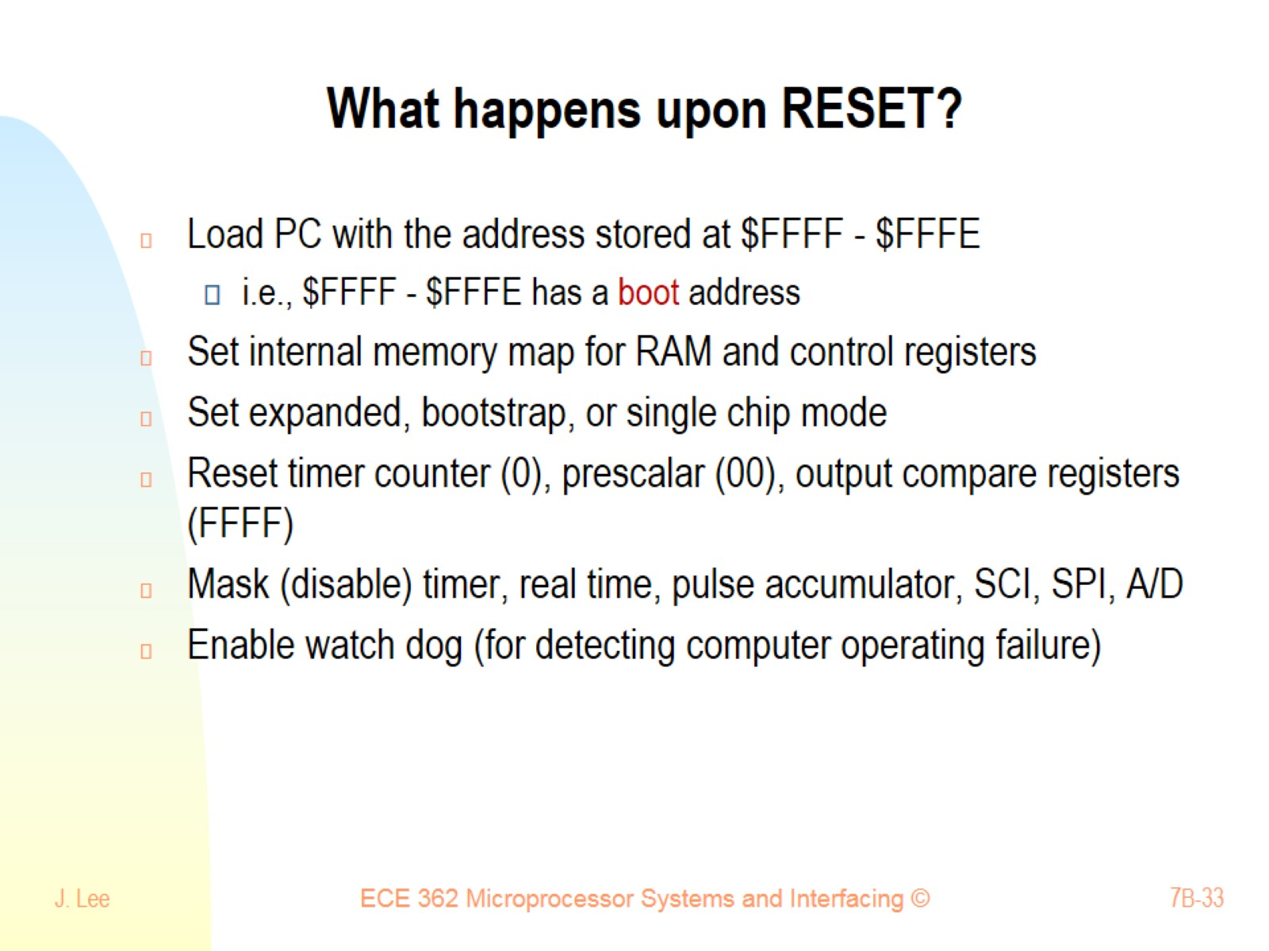
What happens upon RESET?

